Slide 1
Note to presenter
A number of slides include places to add information or data from the school itself. If possible, get this information ahead of time so that the presentation is more about SRTS at the specific school than SRTS generically. The data needed includes:
  School enrollment, grades taught, principal’s name
  Number of students living within 1 mile and within 2 miles
  Where it’s situated and its attendance boundaries
  The types of activities the school has, etc.

Slide 2
Introduction to Safe Routes to School at [name of school]
[enter date]

Slide 3
Outline
Introductions
Y/Our school
What is Safe Routes to School (SRTS)?
Virginia SRTS Program
Next Steps
Notes:
Presenter notes:
Review outline.

Slide 4
Introductions
Name
Organization
What would you like to get out of
today’s discussion?
Notes:
Presenter notes:
Ask meeting attendees to introduce themselves by providing their name, organization/role, and, if feasible considering available time and the number of meeting attendees, the reason why they came or what they were hoping to get out of the discussion.

Slide 5
Y/Our school
[name and grades taught]
[principal's name]
[a bit of information about the school, including where it’s situated and its attendance boundaries, the types of activities the school has, etc.]
[one or two photos of school or activities or kids at school]
[USE ONE OR TWO SLIDES FOR THIS INFORMATION]
Notes:
Presenter notes:
Even if you are presenting to a group of people from your school, it is often helpful to start with some basic information. This provides a frame of reference for all participants and helps you set the stage for the SRTS message.

Slide 6
Existing Travel Modes and Distance to School
Existing Travel Modes
Distance to School
Mode to/from School | %Students
Walk
Bike
School Bus
Family Vehicle
Carpool
Transit
Other
Distance to School | %Students
Within 1 mile
With in 2 miles
Notes:
Presenter notes:
You may get the information needed to fill out these tables ahead of time and include it on the slide. Alternatively, you can ask the audience for their estimate, or use a combination of both.
Message:
This slide shows how students currently get to school—the table on the left--and the percentage of students who live within 1 mile and 2 miles—the table on the right. Let’s focus on the first two rows of each of these tables.
On the left we see that X percent of students currently walk. On the right we see that X percent of students currently live within 1 mile of school. Since 1 mile is a comfortable walking distance for most/many students, this gives us a sense of what this school’s potential is for increasing the number of students who regularly walk to school if we can improve walking conditions and implement appropriate education, encouragement, and enforcement measures.
On the left we see that X percent of students currently bike. On the right we see that X percent of students currently live within 2 miles. Two miles is a comfortable bicycling distance for most/many students, so this gives us a sense of the potential to increase the share of students who regularly bicycle to school, again if we can implement appropriate measures to improve things.

Slide 7
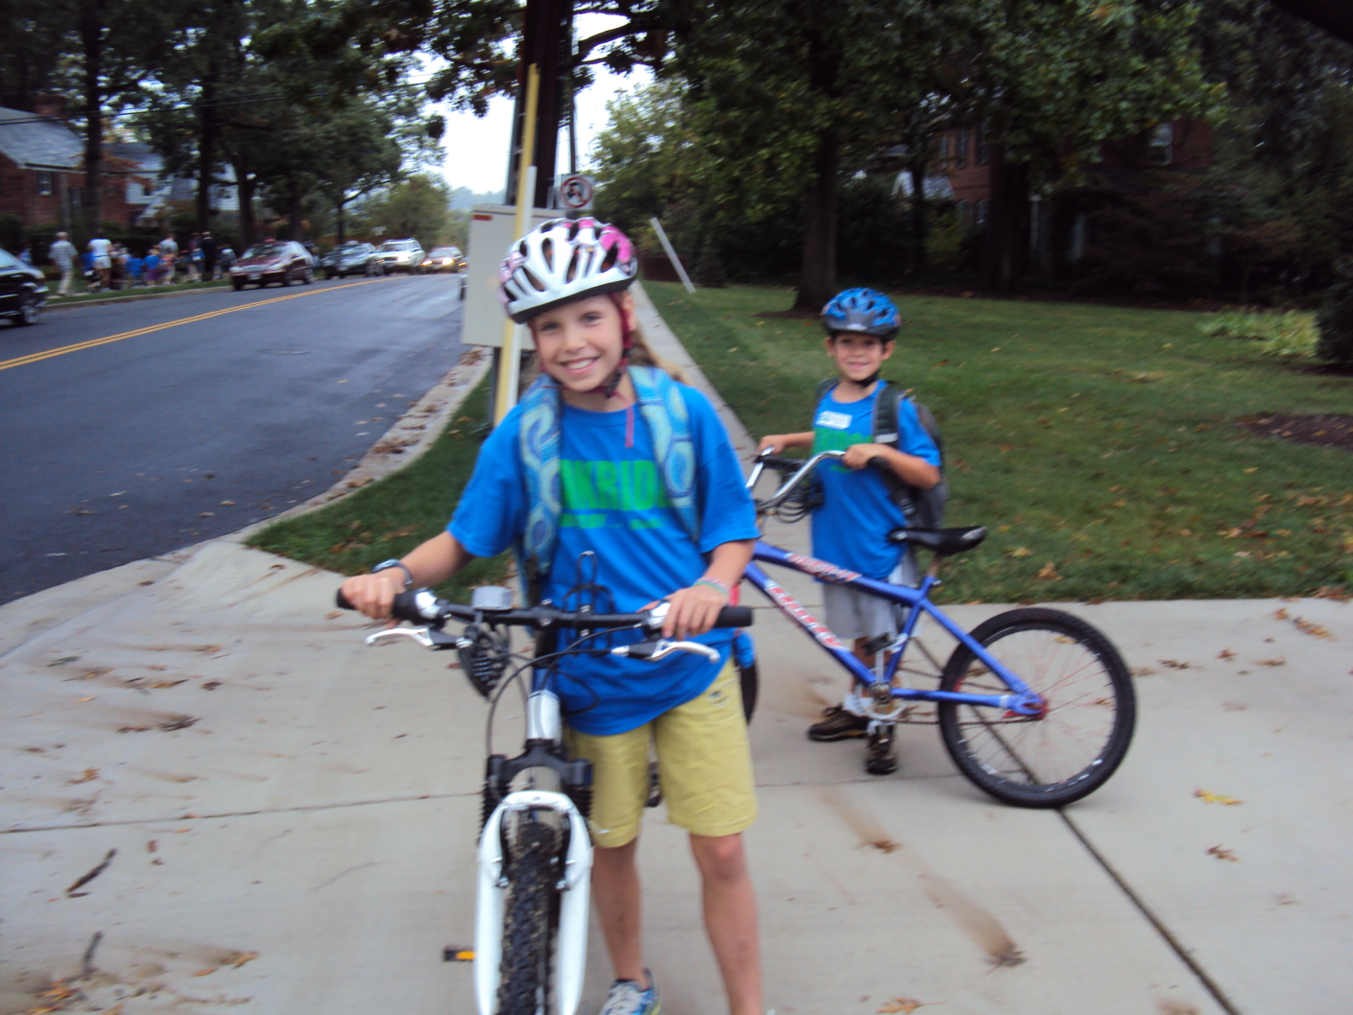
What is Safe Routes to School?
Oak Ridge Elementary, Arlington
Notes:
Message:
So, what is Safe Routes to School?
Some of you may already know the answer to this question, but for those who are less familiar, we wanted to give you a brief overview of the program.
Image: Walk To School Day (October 2012) at Oakridge Elementary in Arlington, Virginia

Slide 8
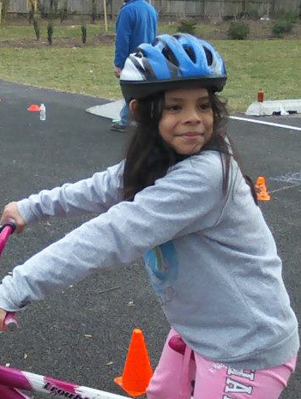
What is Safe Routes to School?
A grassroots effort aimed at increasing the number of students who walk and bike to school by
Improving safety along walking and bicycling routes
Encouraging more children (and their parents!) to walk and bike to school
Also a state-level program in Virginia
Lynbrook Elementary, Springfield
Notes:
Message:
Safe Routes to School is a grassroots effort to:
Improve safety along walking and bicycling routes; and
Encourage more children and their parents to walk and bicycle to school.
By grassroots I mean that SRTS is typically something that is initiated and carried forward at the grassroots level by members of the school community. That’s why we’re here.
There is also a state-level SRTS program in Virginia. The program receives funding from the federal government, which establishes parameters for how the funding can be used, including that the funds are limited to schools that include grades K-8.

Slide 9
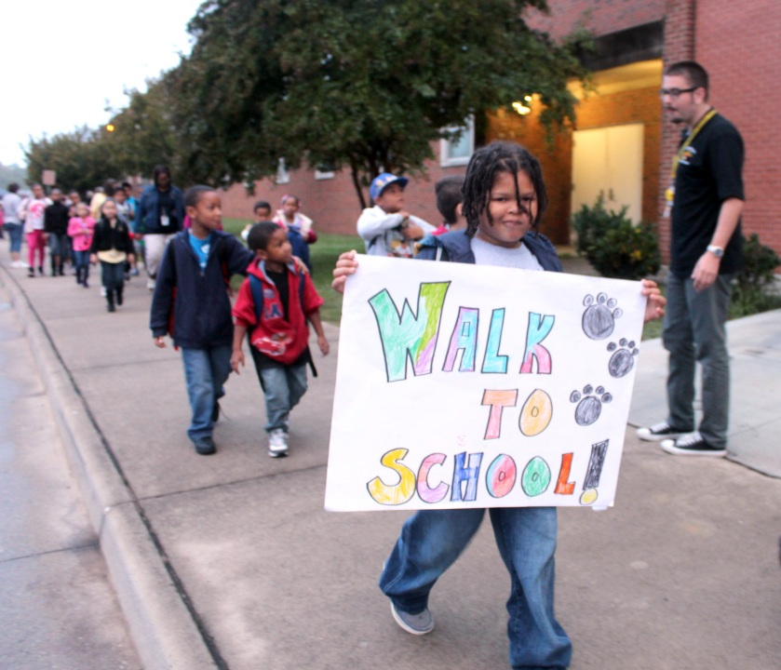
Core Benefits of SRTS programs
Improve safety for pedestrians and bicyclists
Improve children’s health
Reduce traffic congestion around schools (especially during arrival and dismissal)
Reduce emissions
Albert Harris Elementary, Martinsville
Notes:
Message:
Core benefits of SRTS programs include:
Improving safety for pedestrians and bicyclists.
Improving children’s health by giving children the opportunity to get the physical activity they need
Reducing traffic congestion and vehicle emissions around schools (which may impact air quality).
Image: Walk To School Event on October 3, 2012 in Albert Harris Elementary School (Martinsville, VA)

Slide 10
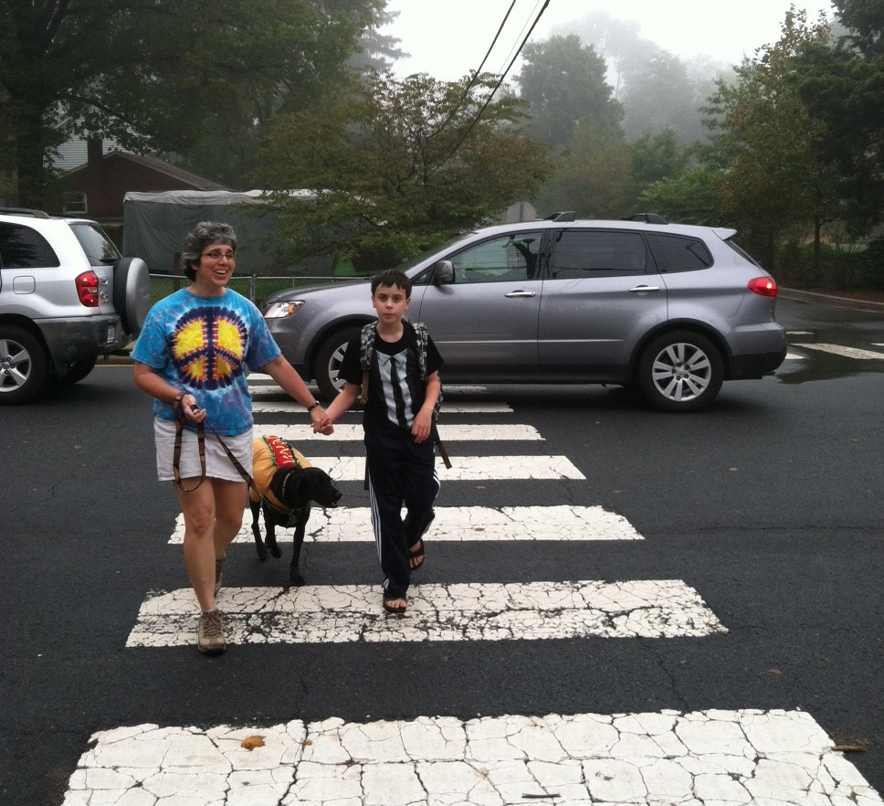
Other benefits of SRTS programs
Students and parents
  Learn fundamental safety skills
  Improve academic performance
  Strengthen family bonds
  Increase child’s sense of freedom and responsibility
Louise Archer Elementary, Vienna
Notes:
Message:
SRTS programs can have numerous other benefits. For example, SRTS programs can:
Teach students fundamental safety skills and remind drivers to watch out for children.
Improve academic performance, because physical activity and academic performance are linked. This is a good one for principals to be aware of!
Give parents and children the chance to walk and bicycle together – strengthening family bonds.
And , for older children, increase students’ sense of freedom and responsibility.
://www.cnt.org/repository/Hazard-Busing-Report.pdf.

Slide 11
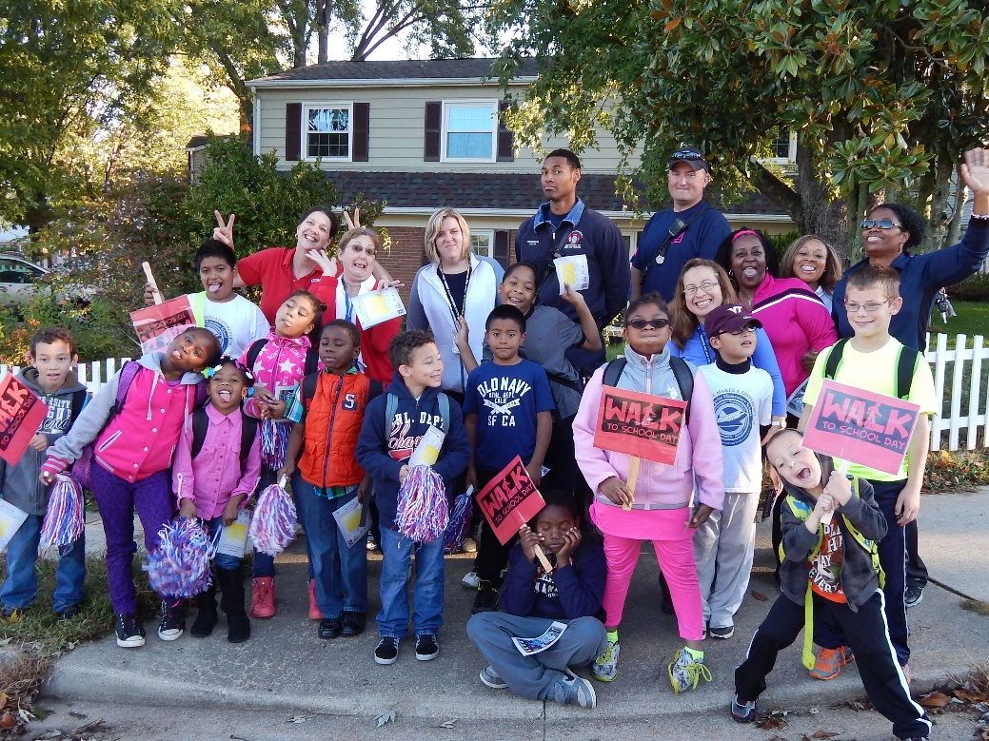
Other benefits of SRTS programs
Schools
  Cost savings for schools, e.g., reduce need for “hazard” busing
Community
  More transportation options
  Benefit local economy
Enterprise Elementary, Woodbridge
Notes:
Message:
And here’s how SRTS can benefit schools and communities.
Schools can save money when SRTS programs help reduce the need for hazard busing (Hazard busing is when bus service is provided for children who live close to school because the routes are not safe for walking).
Communities can benefit through more transportation options for everyone and economically, since communities that support walking and bicycling tend to be more desirable (increasing property values) and tend to generate more retail activity.

Slide 12
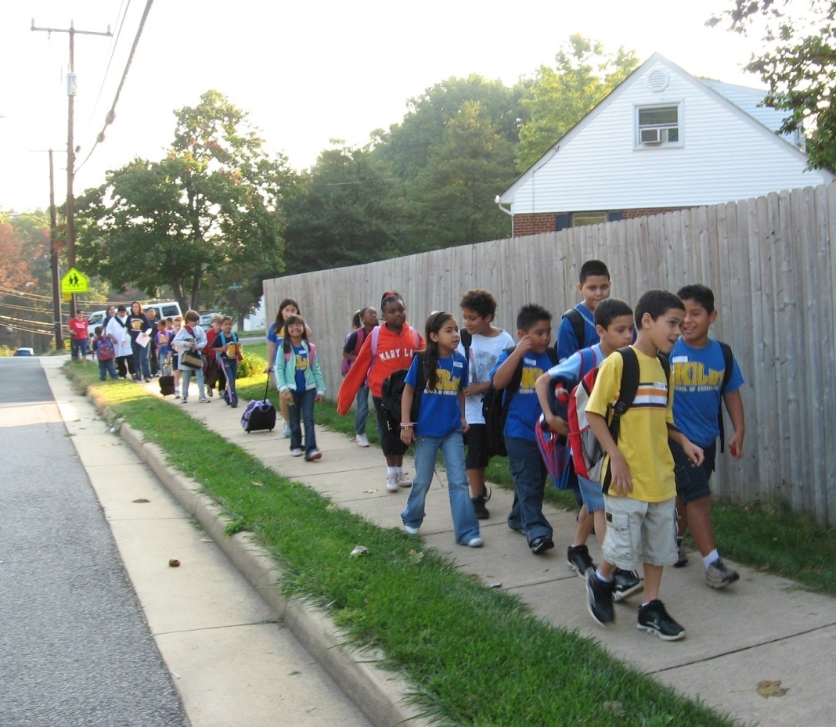
Elements of SRTS programs
Transportation problems are complex, requiring multi-pronged solutions
Education
Encouragement
Enforcement
Engineering
Evaluation
Equity
Kilby Elementary, Woodbridge
Notes:
Message:
Safe Routes to School Programs are structured around the six Es of SRTS, education, encouragement, enforcement, engineering, and evaluation
There’s a reason for this that sometimes gets lost, which is that transportation issues are complex and multi-faceted and, therefore, require multi-pronged solutions.
Take speeding as an example. Does it usually suffice to put in a speed limit sign? No, you usually need to do more than that.
Over the next few slides I’m going to talk about each of the Es in a little more detail. In each case we’re going to return to this speeding example, and I’m going to ask you to brainstorm ways to address it within that E.
Image:
Kilby Elementary, Woodbridge, VA provided by www.iwalktoschool.org.

Slide 13
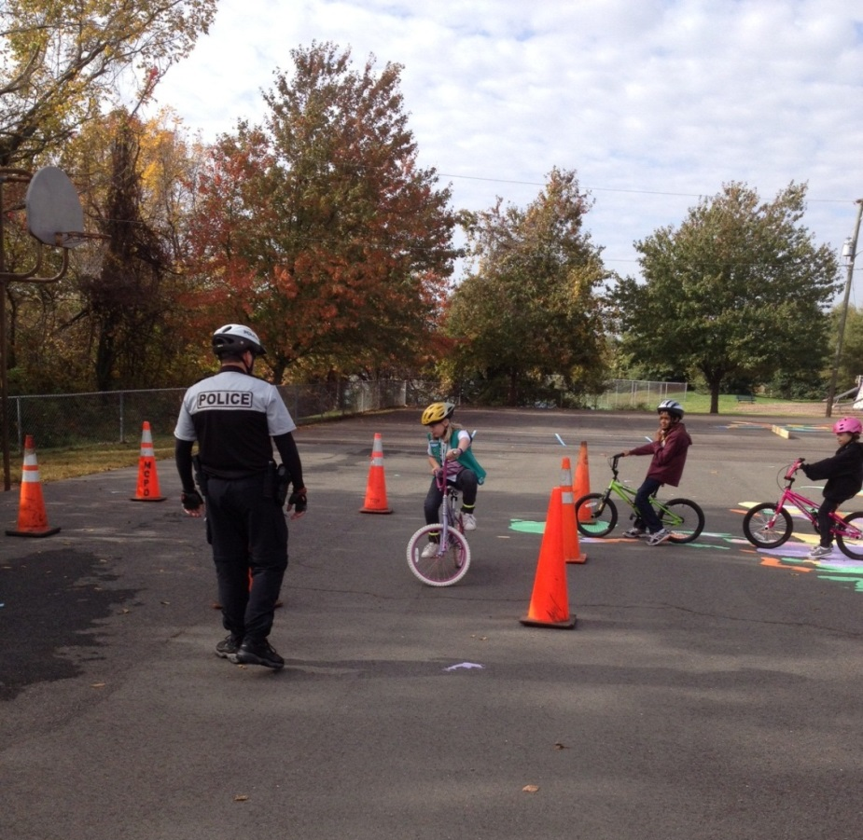
Education
Teaches safety skills
Creates safety awareness
Fosters life-long safety habits
Includes parents, neighbors and other drivers
Cumberland Elementary, Cumberland
Notes:
Message:
My guess is that when most of you think of education in connection with SRTS, you think of pedestrian and bicycle safety education for students. This assumption is correct. Pedestrian and bicycle safety is really a critical component of SRTS, both for kids who are currently walking to school or could walk to school and for kids who can’t. At some point in everyone’s life they are a pedestrian or a bicyclist, and a key goal of SRTS is to develop lifelong pedestrian and bicycle safety skills.
But education in the SRTS context is about more than pedestrian and bicycle safety education. It’s also about increasing awareness among parents and community members. about SRTS and the impacts of travel choices and behaviors.
So, what are some ways that we can use education to address the problem of speeding?
Relate to your school: In what ways is this school already educating students, parents, and community members about SRTS-related issues?
Image:
Cumberland Elementary School Bike Rodeo (Mini-Grant Recipient)

Slide 14
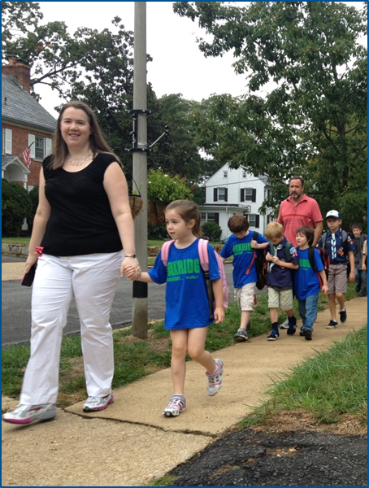
Encouragement
Increases popularity of walking and biking
Is an easy way to start SRTS programs
Emphasizes fun of walking and biking
Oak Ridge Elementary, Arlington
Notes:
Message:
Encouragement is really about shifting the culture. For many years that culture has revolved around cars and has been reinforced by infrastructure investments that privilege cars, all of which has resulted in a substantial decline in the percentage of children who walk or bicycle to school. It’s the sort of decline that feeds on itself, since the fewer kids walk and bike, the more traffic there is near schools, and the more dangerous walking or biking seems.
What we’re trying to do with encouragement is reverse this downward spiral by highlighting and celebrating walking and bicycling, and the behaviors that support walking and bicycling.
So, what are some ways that we can use encouragement to address the problem of speeding?
Relate to your school: In what ways this school is already using encouragement to shift the culture of travel?
Image:
Oakridge Elementary, Arlington

Slide 15
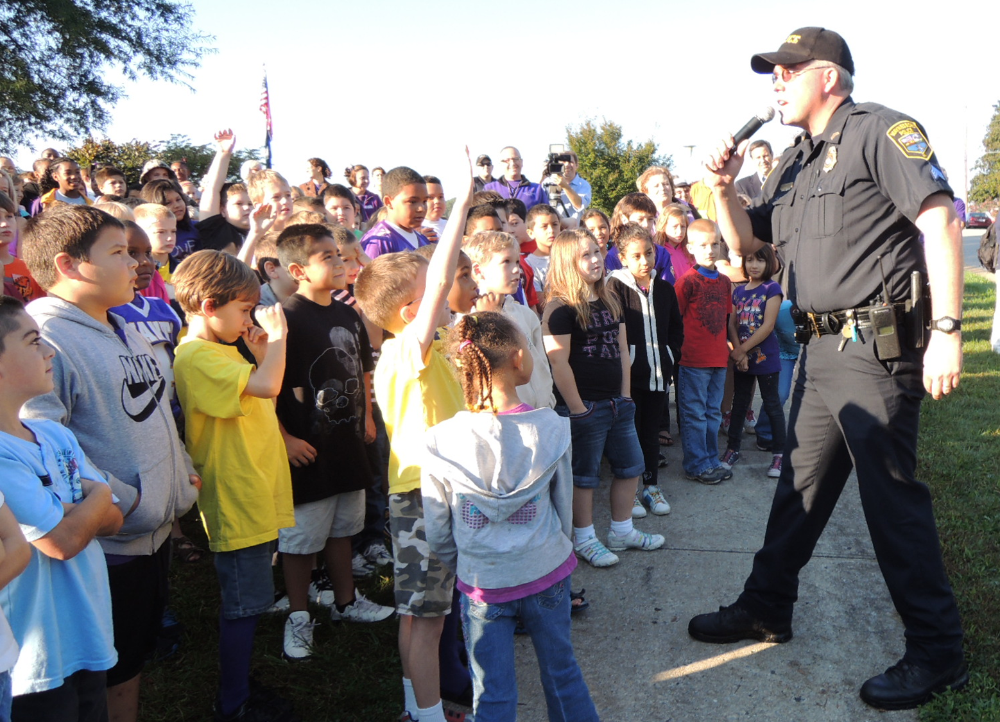
Enforcement
Increases awareness of pedestrians and bicyclists
Improves driver behavior
Helps children follow traffic rules
Decreases parent perceptions of danger
Berkeley Glenn Elementary, Waynesboro
Notes:
Message:
The primary goal of enforcement is to make walking and bicycling to school safer by improving driver, pedestrian, and bicyclist behavior and addressing concerns about personal security.
Enforcement isn’t just a matter of ticketing. It’s also a matter of education and awareness. What are the rules people should be following? When are they violating those rules? Sometimes people just aren’t sufficiently aware. Such education and awareness efforts should generally precede ticketing.
Many people can and should be involved in enforcement. Police officers, of course, but also school administration and staff members, crossing guards, parents, and student safety patrols.
So, what are some ways that we can use enforcement to address the problem of speeding?
Relate to your school: What enforcement-related efforts are already going on at our school?
Image:
Berkeley Glenn Elementary Walk to School Week (VA Mini-Grant Recipient)
Police Officer quizzes students on pedestrian safety.

Slide 16
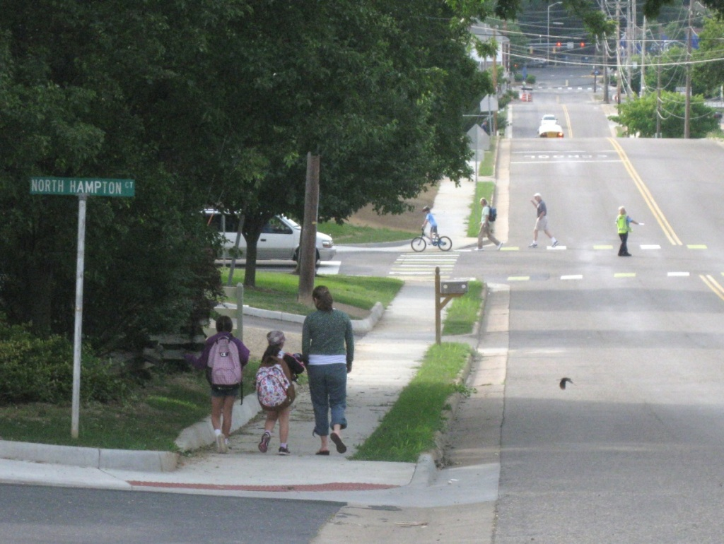
Engineering
Creates safer, more accessible settings for walking and biking
Can influence behavior
Important to relate needs near schools to our community’s overall transportation system.
Keister Elementary, Harrisonburg
Notes:
Message:
Engineering is what most people gravitate toward when they think about the barriers to walking and biking to school. They point to the lack of sidewalks, crosswalks, and other needed pedestrian and bicycle infrastructure. And, of course, addressing such needs is a very important aspect SRTS. It is where engineering comes in. Engineering deals with the built environment and projects that work to create safe and accessible places to walk or bike.
So, what are some ways that we can use engineering to address the problem of speeding?
Relate to your school: What types of changes to the streets near this school have improved conditions for walking and bicycling?
Image(s)
Sidewalks and crossing improvements along walking routes to Keister Elementary School in Harrisonburg.

Slide 17
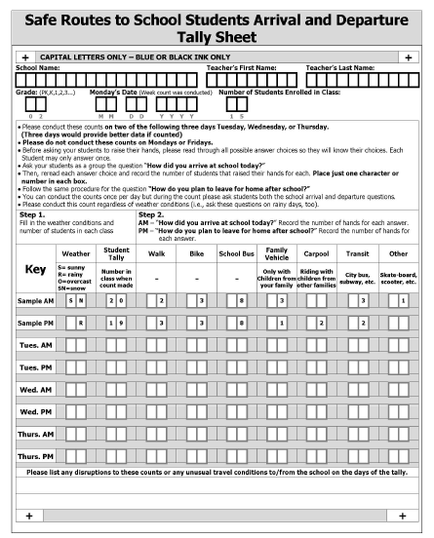
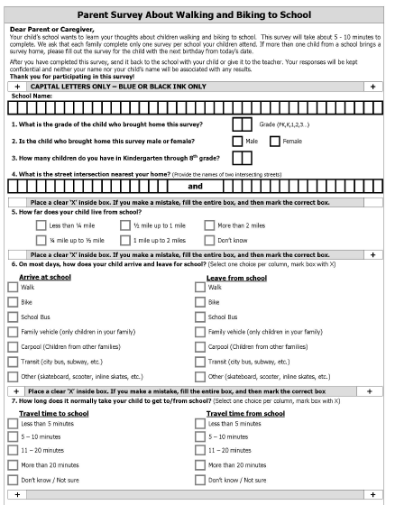
Evaluation
Is the program making a difference?
Student Travel Tally Week
is any week in September or October
Notes:
Message:
Evaluation helps you measure the impact of your efforts over time.
Before we talk about some of the most commonly-used evaluation tools, what are some ways we could measure the impact of efforts to reduce speeding near a school?
Speed study
Student Travel Tallies
One of the most commonly used tools for evaluation is the Student Travel Tally, shown here on the right. Student Travel Tallies are conducted by teachers in the classroom. Over two or preferably three-day period, teachers ask students to raise their hands to indicate the mode they used to travel to school and the mode the plan to use to travel from school.
Student Travel Tally Week
The Virginia SRTS Program sponsors an annual event to encourage schools to take Student Travel Tallies. Schools choose any week either September or October. This is done to encourage schools to collect tallies at the same time every year, since tallies collected at the same time are more comparable.
The data also helps the Virginia SRTS Program evaluate progress statewide.
Parent Survey
The Parent Survey is another commonly used evaluation tool. This is a two-page form that asks parents about how their child usually travels to and from school and any concerns they may have about their child walking or biking.
The Parent Survey is a good compliment to the Student Travel Tally, since it asks about a child’s usual mode to school, whereas the Student Travel Tally only picks up the mode to school on particular days, which may or may not be representative. Understanding and addressing parent concerns is also critical for increasing rates of walking and biking to school, since parents are the one’s who decide how their children get to school.
Both the Student Travel Tally and the Parent Survey were developed by the National Center for Safe Routes to School and are available on the website saferoutesdata.org
Images:
Provided by National Center for Safe Routes to School, www.saferoutesinfo.org

Slide 18
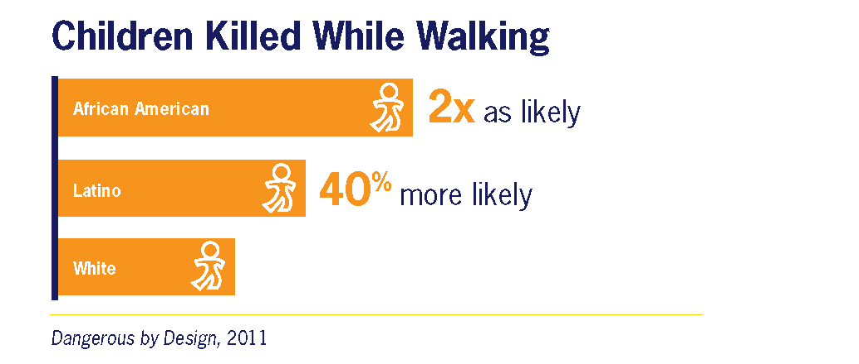
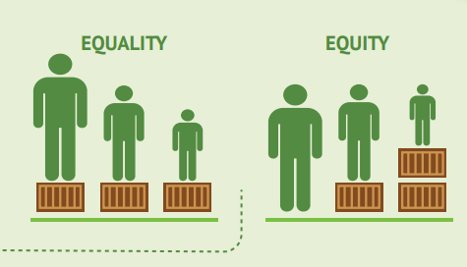
Equity
  Needs-based approach to allocating resources to achieve fair distribution of benefits and costs.
  Children from lower-income families are twice as likely to walk to school as children from higher-income families but typically face greater personal and traffic safety risks on their route to school.
http://www.recoftc.org/
Notes:
Message:
Equity is an important consideration in Safe Routes to School projects. Walking and bicycling need to be safe and convenient for everyone. However, these activities are currently more dangerous and less available in low-income communities and communities of color. For example, African American children are twice as likely as White children to be killed while walking.
There are a number of things that can be done promote equity through SRTS.
First, understand where the needs are in your community. Where are crashes involving pedestrians and bicyclists most prevalent? Where are high numbers of children currently walking or biking in unsafe conditions?
Second, allocate time and resources in proportion to the observed needs. That is, areas with the greatest need should receive the greatest share of time and resources.
Third, develop an inclusive communications strategy. For example, education materials should be provided in multiple languages for students to share with their families. Classroom activities should enable students of all abilities to participate.
Fourth, partner with community organizations. For example, faith-based organizations, neighborhood coalitions, and housing groups may have the community knowledge and human resources to help organize and support walking school buses and corner captain programs.

Slide 19
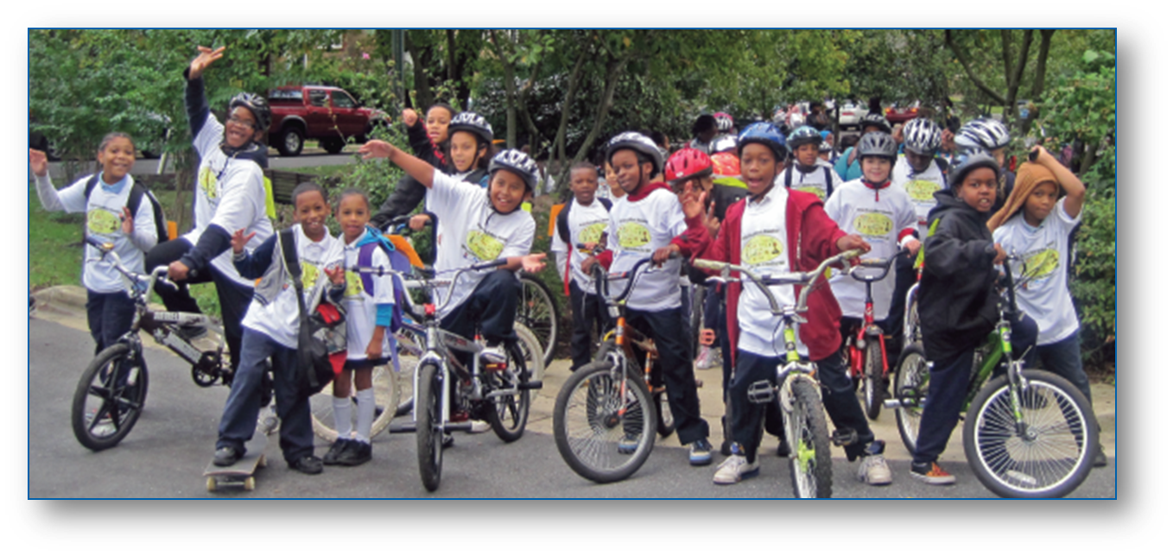
Virginia’s SRTS Program
www.virginiadot.org/saferoutes
Notes:
Message: Now that we have a better idea about what SRTS is, let me tell you a bit about the Virginia SRTS program.

Slide 20
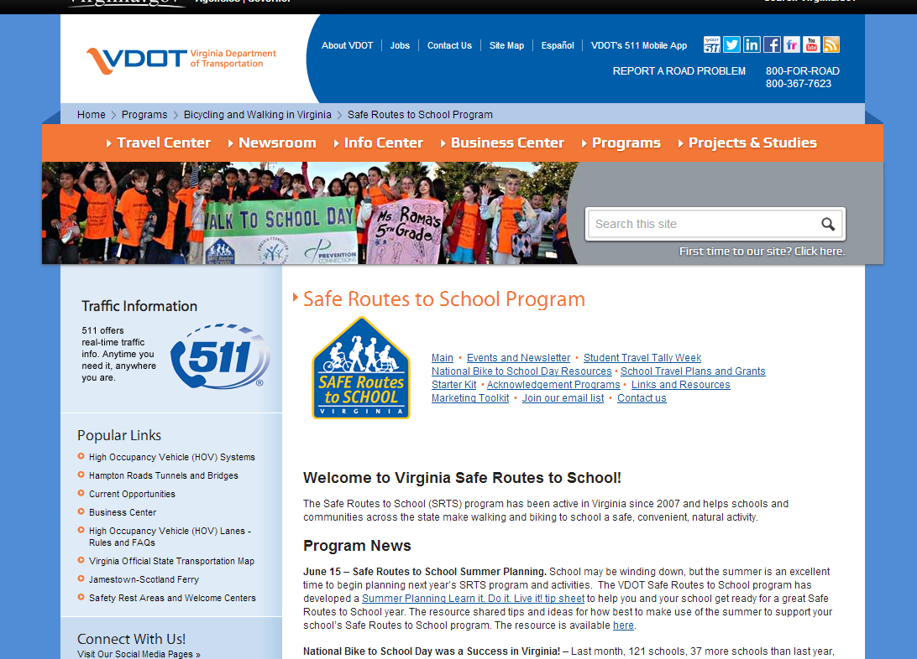
Role of Virginia’s SRTS Program
Provides support through
Funding
Technical assistance
Other resources
Encourages a comprehensive approach at a grassroots level
Notes:
Message:
The Virginia SRTS program provides support to local SRTS programs through technical assistance, funding, and other resources. Recognizing that SRTS efforts are unlikely to be successful without taking a comprehensive approach or garnering support at the local, grassroots level, this is what Virginia program seeks to foster and encourage. And it does so in a variety of ways, including through:
VA SRTS Program website
VA SRTS Program newsletter and eblasts
Technical assistance through VA SRTS hotline (1-855-601-7787) and info@ email account (info@virginiasrts.org)
All of these are aimed at creating sustainable local programs, i.e., grass roots programs.

Slide 21
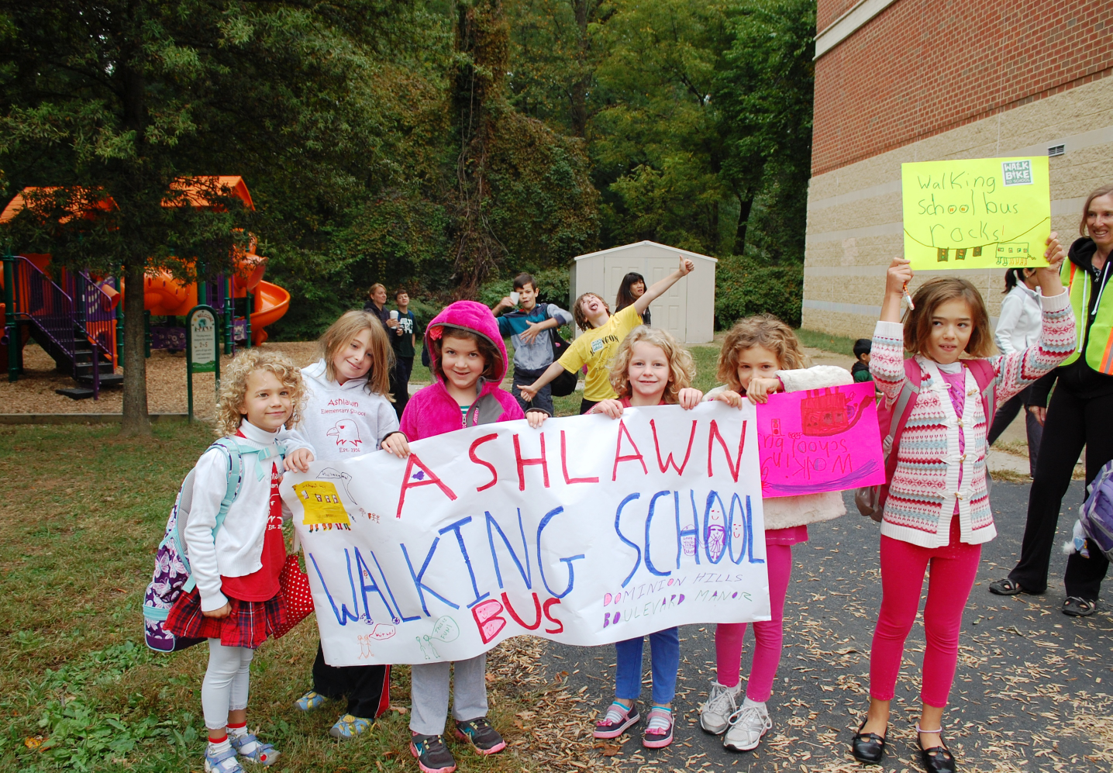
Virginia’s SRTS Program - Objectives
Enable participation on a variety of levels
Make program adaptable to participants in urban, suburban, and rural communities
Promote comprehensive local SRTS programs and activities
Promote sustainable local programs
Maximize impact of available funds
Ashlawn Elementary, Arlington
Notes:
Message:
The objectives of the Virginia SRTS program are to:
Enable participation on a variety of levels. In other words, the program supports participation by local communities at whatever level fits their needs and circumstances. Some schools may only participate in one or two statewide events each year. Others may participate in all of them, create a SRTS travel plan, and much more. The Virginia program is here to support both levels of involvement.
Make the program adaptable to participants in urban, suburban, and rural communities. SRTS can work any of these environments but the strategies might be a little different. The Virginia program provides can provide ideas about this.
Promote comprehensive local SRTS programs and activities, or programs that take into account the multi-faceted nature of transportation issues by considering all 5 Es of SRTS.
Finally, the Virginia SRTS Program seeks to maximize the impact of available funds for SRTS. I’ll talk next about funding opportunities that are available through the Virginia SRTS Program.

Slide 22

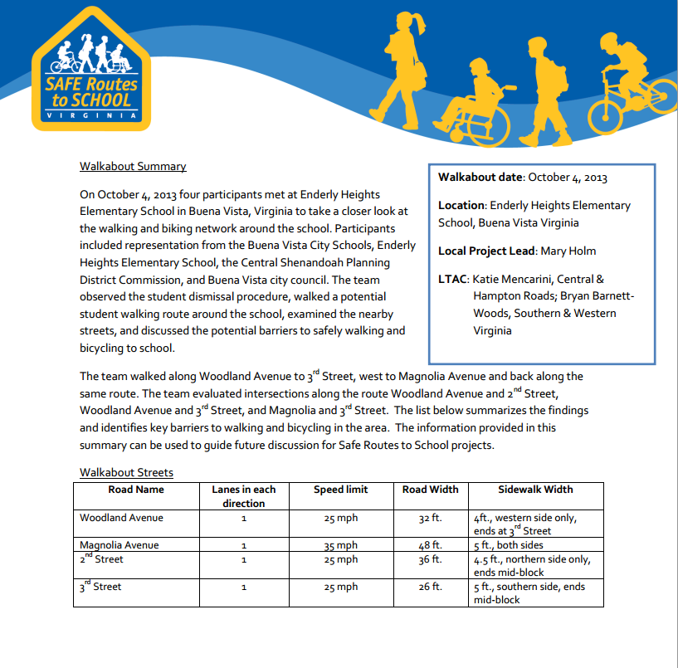
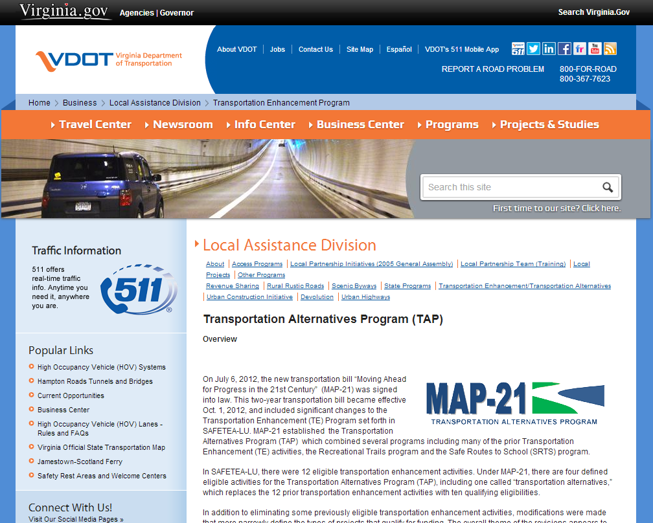
Funding Opportunities
QuickStart Mini-Grant
Walkabout Mini-Grant
Non-infrastructure Grant
Infrastructure Grant
Notes:
Message:
There are multiple ways to fund SRTS efforts. The Virginia SRTS program offers multiple grants:
A Walkabout Grant that helps identify walking and biking infrastructure needs,
A QuickStart Mini-grant that funds small-scale education, encouragement, enforcement, and evaluation strategies,
A Non-infrastructure Grant that funds implementation of multi-school or division-wide education, encouragement, enforcement, and evaluation strategies, including a multi-school or division-wide SRTS coordinator,
and a grant intended to fund infrastructure projects such as sidewalks and crosswalks. I’m going to say a little bit about each of these in the coming slides.

Slide 23

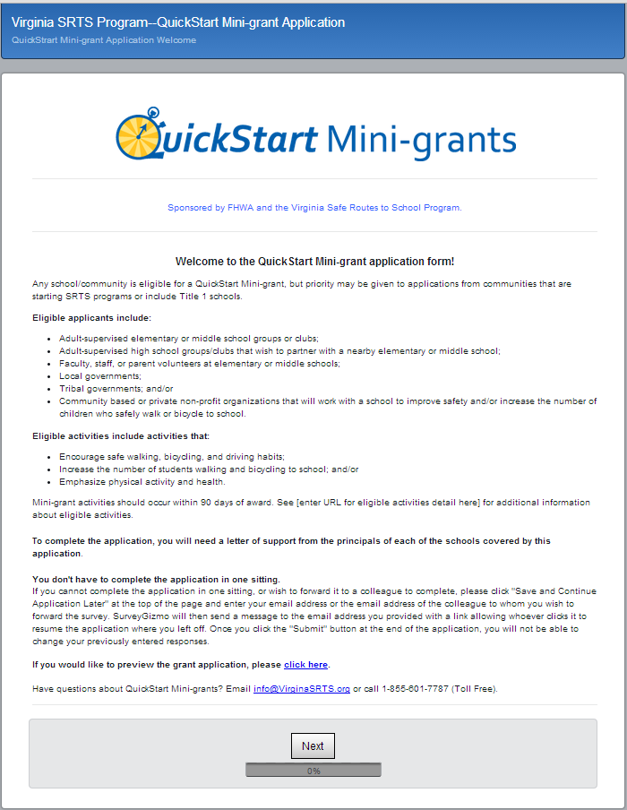
$1,000 mini-grants to schools and non-profits
Easy access to SRTS funds
Online application
Regular application and award cycles
Over 300 mini-grants already awarded
Notes:
Quick-Start Mini-Grants are the low hanging fruit!
These are grants for $1,000 for schools and non-profits.
The online application process is simple and straightforward. and mini-grants are awarded throughout the school year.
Over 300 mini-grants have already been given out to communities across the Virginia. More rounds available this school year. This school could be next!

Slide 24
Examples of Eligible Activities
Start a walking school bus, bicycle train, and/or a “Walking Buddies” program.
Produce a student-led school assembly, play, or a video.
Start safety patrol or club.
Provide walking/ bicycling safety education.
Build a “traffic garden” to assist with safety education.
Track mileage with pedometers.
Collaborate with teachers to integrate walking and bicycling into the general curriculum.
Notes:
Message:
Here are some examples of the types of activities that a QuickStart Mini-grant can support.
QuickStart mini-grants can also be used to purchase small infrastructure items, such bike racks; however, these purchases must be paired with an encouragement or education activity.
Note: A “walking school bus” is a group of students walking to school with one or more adults. Often the walking school bus will take a prescribed route that includes “stops” to pick up children along the way. A “bicycle train” is the same concept but with bikes. Finally, a “traffic garden” is a simulated street environment that is used to teach children about pedestrian and bicycle safety.

Slide 25
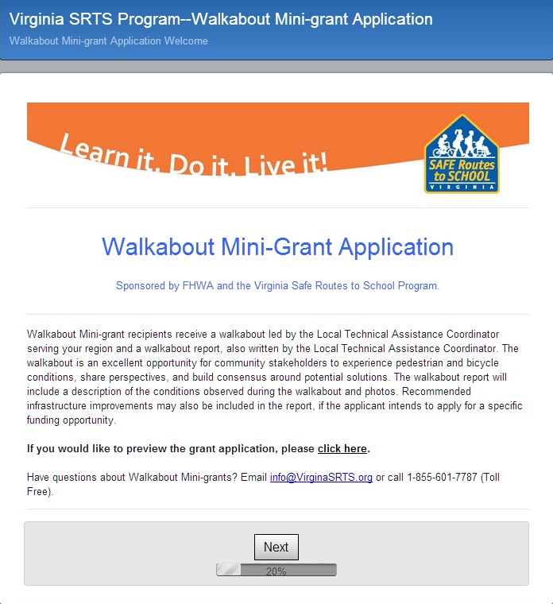
Walkabout Mini-grants
  Observation of school arrival or dismissal
  Assessment of school walking/biking conditions
  Walkabout report
  Brings together key stakeholders to build consensus
  Can be used as basis for infrastructure grant application
  Online application form
Notes:
Message:
Walkabout Mini-grants are another great opportunity. The walkabouts include:
Observation of school arrival or dismissal.
Assessment of walking and biking conditions on and near the school campus.
A walkabout report that documents the walkabout and existing conditions.
Walkabouts have a couple of key benefits for local communities:
First, they are an opportunity to bring together key stakeholders from the school community and local government to build consensus around ways to improve walking and biking conditions.
Second, the walkabout mini-grant report can provide valuable information for an infrastructure grant application, which I will discuss in greater detail below.
You/we can apply for a walkabout mini-grant using the a simple online form. The first page of that form is shown on this slide.

Slide 26
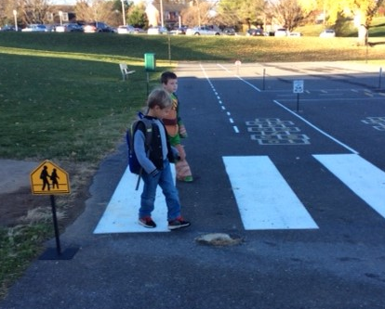
Non-Infrastructure Grants
Fund local coordinator positions
Require an Activities and Program Plan
80-20 match
Applications typically accepted in the winter-spring timeframe
Stone Spring Elementary, Harrisonburg
Notes:
Message:
The third source of funding available through the Virginia SRTS program is the Non-Infrastructure Grant.
The non-infrastructure grant is intended to support multi-school or division-wide SRTS education, encouragement, enforcement, and evaluation efforts. It can also be used to hire a local SRTS coordinator that supports SRTS programs at multiple schools or division-wide.
The first step is to create an SRTS Activities & Programs Plan (APP). The APP is the first phase of any SRTS effort and outlines a school or community’s intentions for making active travel to and from school safer and more sustainable.
The Non-Infrastructure grant can provide up to $100,000 for local SRTS programs; however, the applicant must provide a 20% match. The term “match” refers to the share of funding that a grant applicant is required to provide as part of the grant agreement.
Applications for the Non-Infrastructure grant are accepted annually, typically in the winter/spring timeframe.

Slide 27
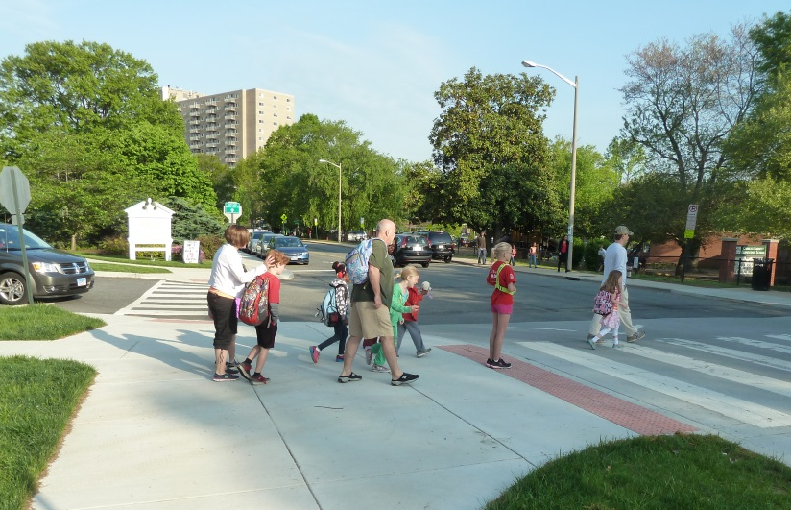
Infrastructure Grants
Transportation Alternatives Program (TAP) administered by VDOT’s Local Assistance Division
Extra points for SRTS projects
20% match required
Compete with non-SRTS projects
Applications due every 2 years in fall-winter.
Charles Barrett Elementary, Alexandria
Details on Local Assistance Division website--http://www.virginiadot.org/business/local-assistance.asp
Notes:
Message:
The fourth source of funding available through the Virginia SRTS Program is the infrastructure grant, which is meant to fund infrastructure projects, such as sidewalks and crosswalks.
Funding from this grant comes from the federal Transportation Alternatives Set-Aside or TA Set-Aside.
At the state-level this program is called the Transportation Alternatives Program or TAP. VDOT’s Local Assistance Division manages it but coordinates with the SRTS program.
Applications for infrastructure funding must compete with other non-SRTS projects; however, SRTS projects earn extra points.
For this grant, a 20% match is required. This means that the local communities must provide 20% of the funding for the project, although this funding can be provided “in-kind” through labor or materials of equivalent value.
Applications are due every 2 years in the fall-winter timeframe. In the past there have been mandatory pre-application deadlines in the summer. Check VDOT’s Local Assistance Division website for schedule details--http://www.virginiadot.org/business/local-assistance.asp.

Slide 28
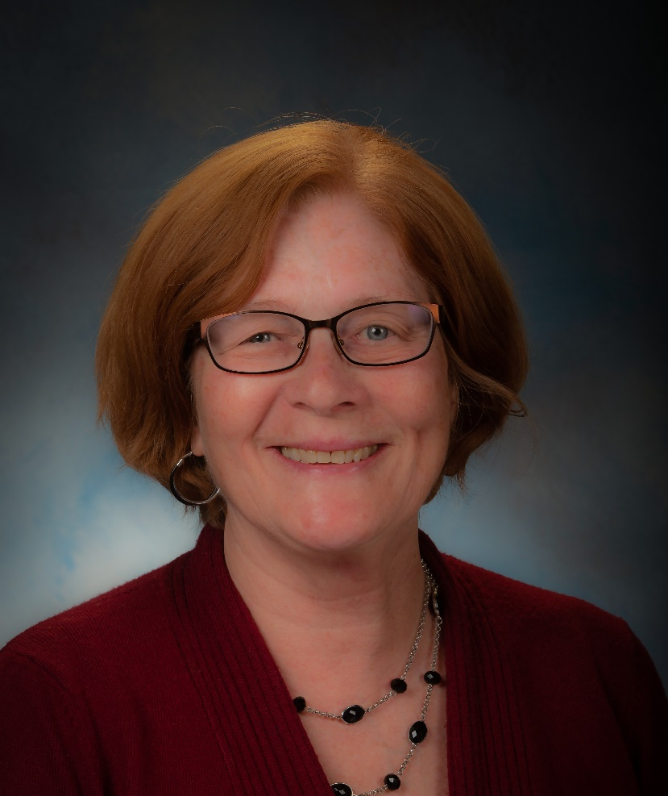
SRTS Coordinator
Katherine Graham
Notes:
Message:
This is Katherine Graham, the Commonwealth of Virginia’s SRTS Coordinator. Katherine is an employee of the Virginia Department of Transportation. She is the one responsible for managing the Virginia SRTS Program.

Slide 29
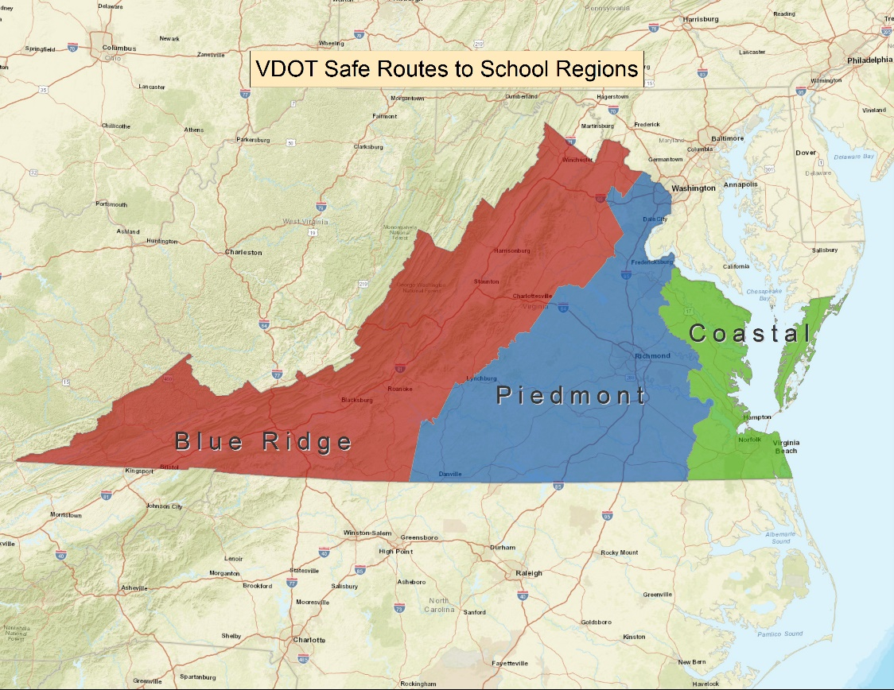
Local Technical Assistance Coordinators
Ways to Contact Your LTAC
Email: info@virginiasrts.org
Toll free hotline: 855-601-7787
Notes:
Message:
Katherine is supported by a team of Local Technical Assistance Coordinators or LTACs who provide technical assistance to local SRTS programs.
There are three LTAC regions—the Coastal Region, the Piedmont Region, and the Blue Ridge Region. The LTACs can be reached by emailing info@virginiasrts.org or calling toll free to 855-601-7787.
The LTAC for our school is X [check http://www.vdot.virginia.gov/programs/srsm_contact_us.asp for name]. S/he can be reached by email or through the Virginia SRTS Program’s toll free hotline.

Slide 30
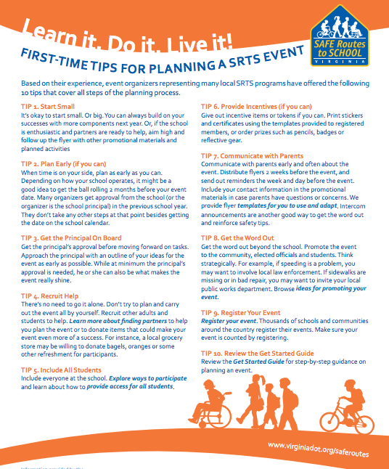
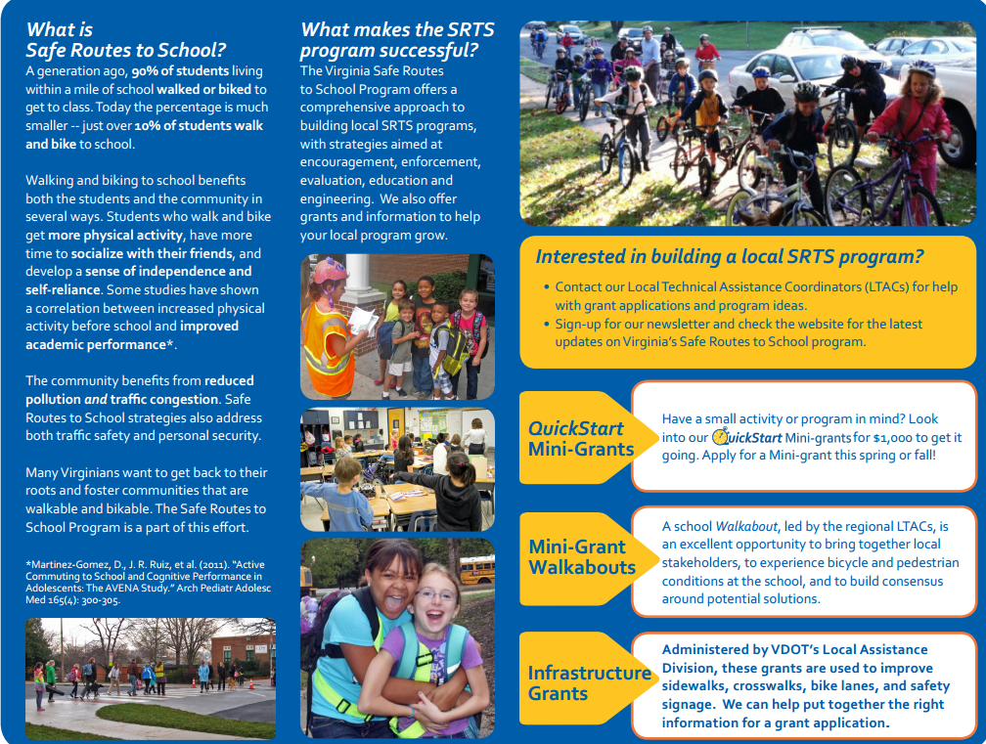

Virginia’s SRTS Program - Resources
Starter Kit
Learn It. Do It. Live It!
Zone In, Not Out
Notes:
Message:
A variety of materials are available on the Virginia SRTS website to assist local SRTS programs, including a kit for SRTS programs that are just starting out, a series of tip sheets called “Learn it. Do it. Live it!” on everything from planning a Walk to School Day to organizing park and walk sites, and a package of resources to promote pedestrian and bicycle safety in the school zone called “Zone In, Not Out.”
Note to instructor:
Grass roots efforts and local SRTS programs are important.
Where SRTS really happens is at the community/local level.
Approach ensures that SRTS becomes part of the community’s way of doing things
The Starter Kit: This digital compilation of templates, tip sheets and more will help get your program up and running is waiting for you on the website.
Theme: Learn It. Do It. Live It!: A new series of tip sheets to help you with various program activities.
Starter Kit, resources, workshops can be used to learn it.
You will actually “Do It.” by starting your applications and SRTS APP
The hope is that you will “Live It.” and make these life-long skills.
VDOT support for local programs includes…

Slide 31

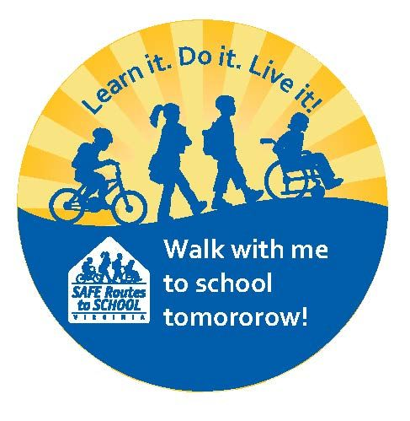
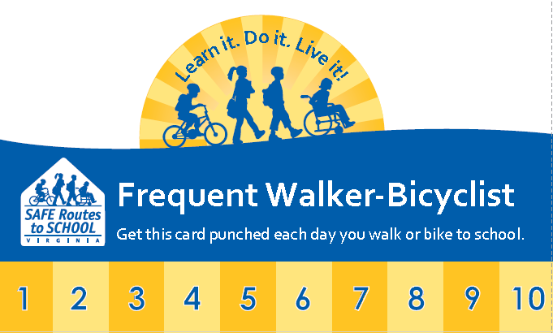
Virginia’s SRTS Program – Resources
Promotional/Marketing Material
Notes:
Message:
The Virginia website also includes materials marketing and promoting SRTS, such as the sticker, frequent walker, and certificate templates shown here.

Slide 32
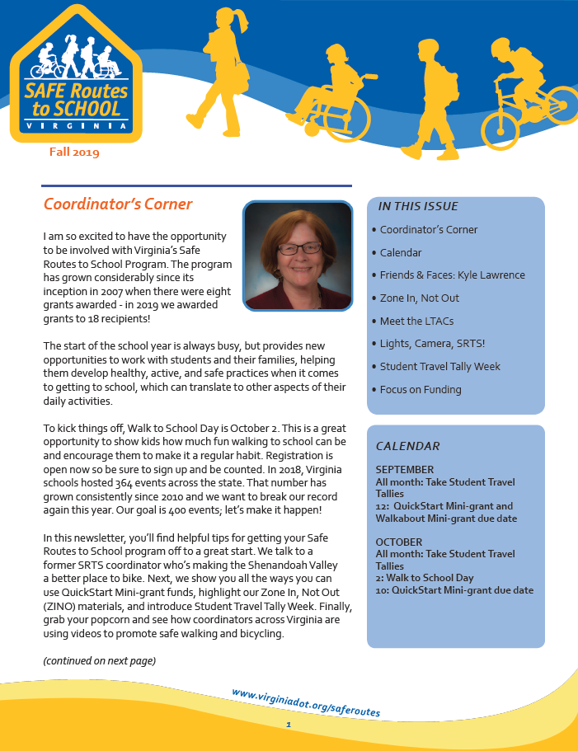
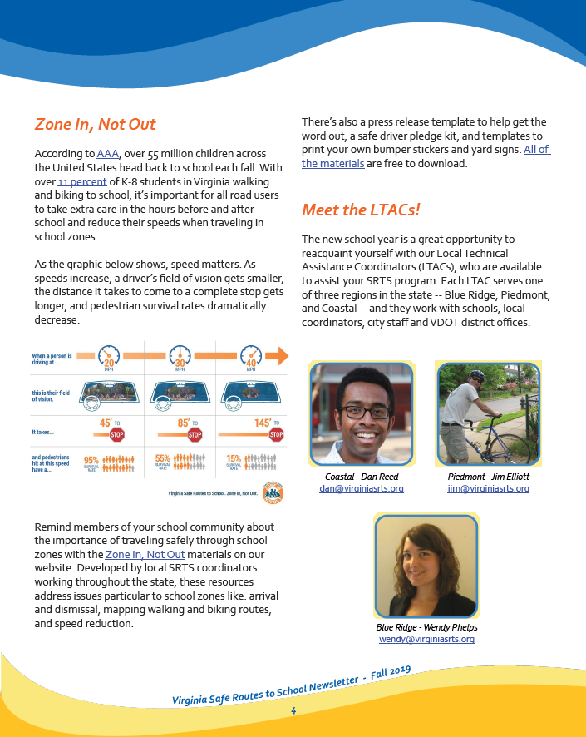
Virginia’s SRTS Program – Newsletter
Sign up at: www.virginiadot.org/saferoutes
Notes:
Message:
Finally, the Virginia SRTS program has an email list you can join to receive newsletters and eblasts. Newsletters come out 3-4 times per year and include information on upcoming events and funding as well as articles on people working to create Safe Routes to School. You can sign up through the Virginia SRTS website--www.virginiadot.org/saferoutes. Just click on “Join our email list” at the top of the page.

Slide 33

This the right time for SRTS at y/our school
In general, there is
  Increasing interest in walking and bicycling
  National concern over childhood obesity
  “Green” movement
What are the reasons we can think of for starting a SRTS program here?
Notes:
Message:
The time is right for SRTS:
More communities are expressing interest in walking and bicycling to school.
There has been increasing national concern over childhood obesity.
Relate to your school: What are the reasons we can think of for starting a SRTS program?
Ask those present to suggest reasons.

Slide 34
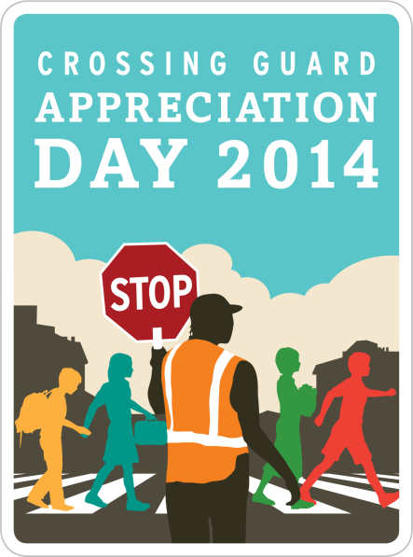
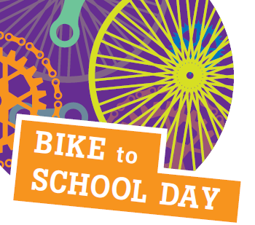
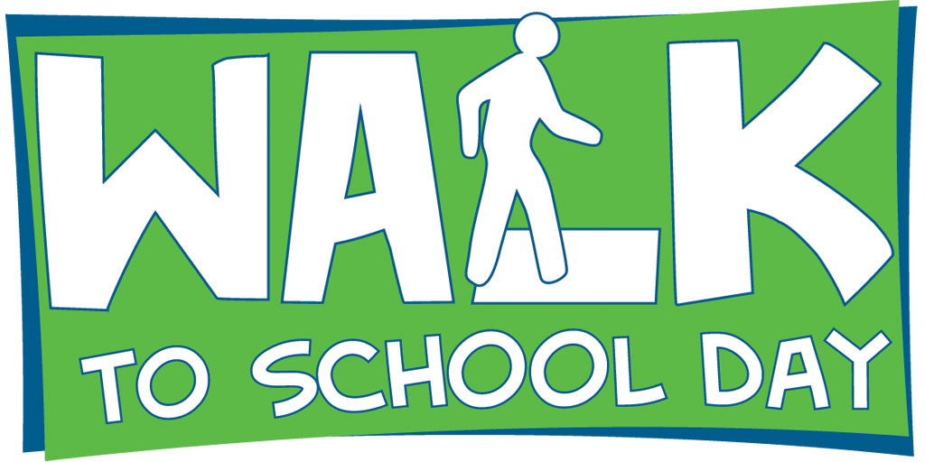

Opportunities for encouragement and education events
Student Travel Tally Week, September and October
Walk to School Day, October
Crossing Guard Appreciation Day, February
Bike to School Day, May
Weekly or monthly walking and biking events
See VA SRTS website for exact dates: http://www.vdot.virginia.gov/programs/srsm_events.asp
Notes:
Message:
There many ways to participate in SRTS. This slide shows some of them, including the dates of key statewide events like Walk to School Day and Bike to School Day. You can find resources to support each of these events on the Virginia SRTS Program website. Additional resources are available from WalkBiketoSchool.org.
Lots of Virginia schools and communities are participating in these events.
Relate to your school: Which one of these events makes the most sense for us to start with?

Slide 35
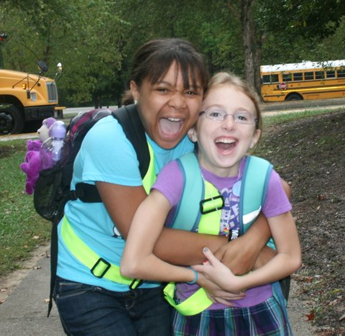
Next steps?
Notes:
Message:

