Slide 2
Transportation Technology
STEM in Transportation
2020

Slide 3

How much do you know about transportation technology?
Let’s go to Kahoot and find out!!
Kahoot Game: Vehicle Technology
www.kahoot.it to play
Notes:
The Kahoot can be found here: https://create.kahoot.it/share/vehicle-technology/2eb311e7-3443-4d5e-b459-b10c202122b1

Slide 4





Answering
Notes:
This Kahoot can be done even without students have access to devices. Have the students stand up. If they think the answer is in the Red rectangle, have them put there hands together over their head (picture as a reminder). If they think the answer is in the Blue box, they can stand with their hands straight down to their sides. If they think Yellow is the correct answer, stand with hands on hips, and if they think Green is the correct answer, stand like an X (hands up and out and feet apart). This adds some fun and gets the students moving. ☺
All of the answers to the questions have not been reviewed in the presentation. These are just fun transportation questions and the students use their best judgment to guess the correct answer.

Slide 5
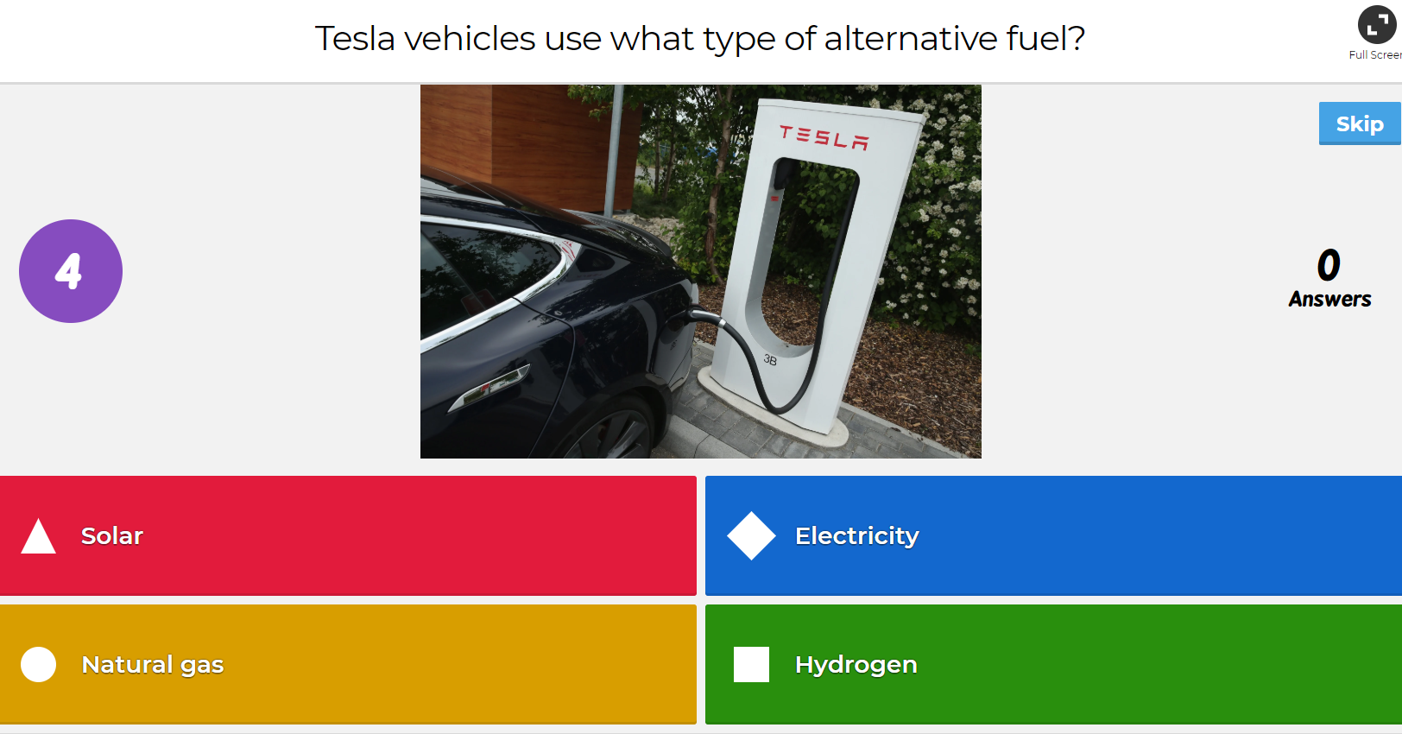

Question 1

Slide 6
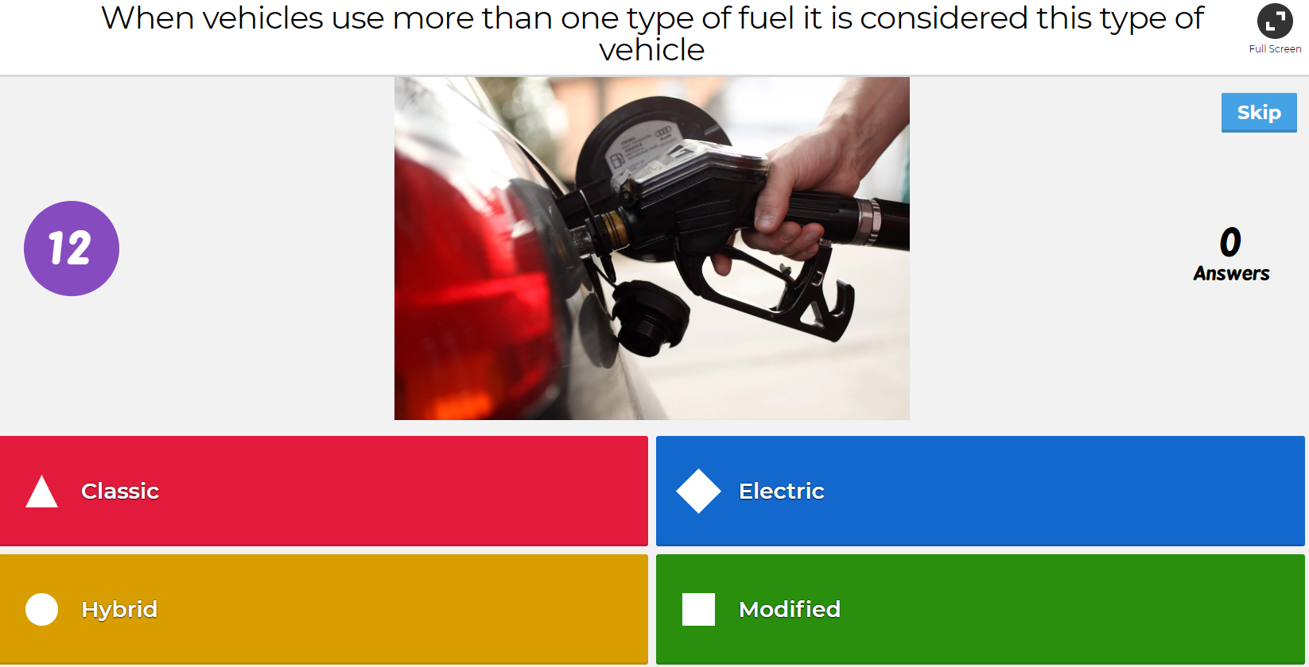
Question 2

Slide 7
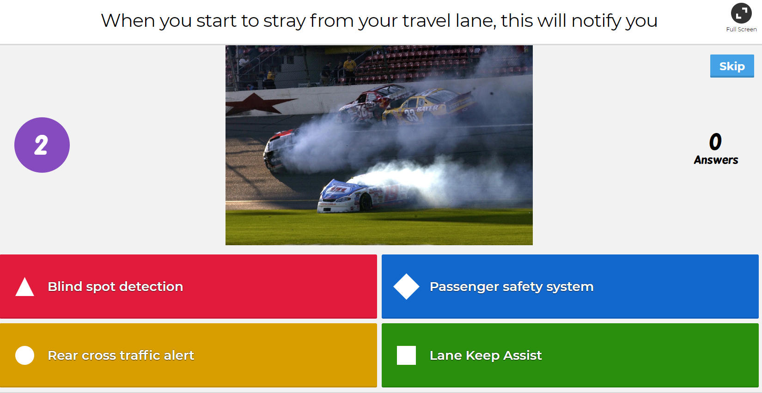
Question 3

Slide 8
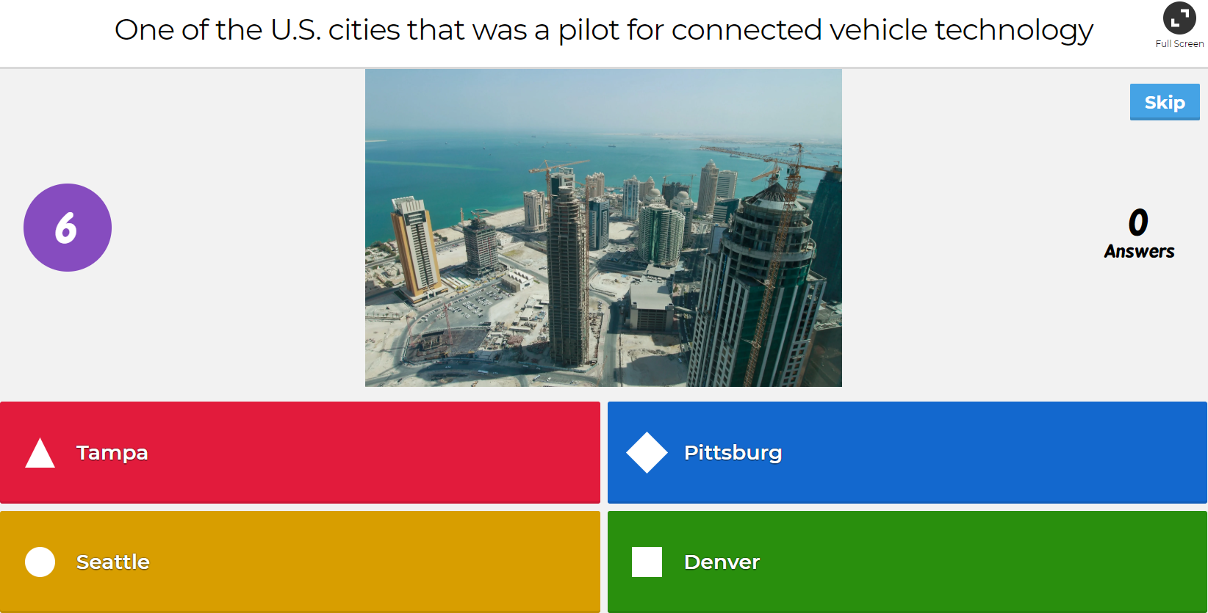
Question 4

Slide 9
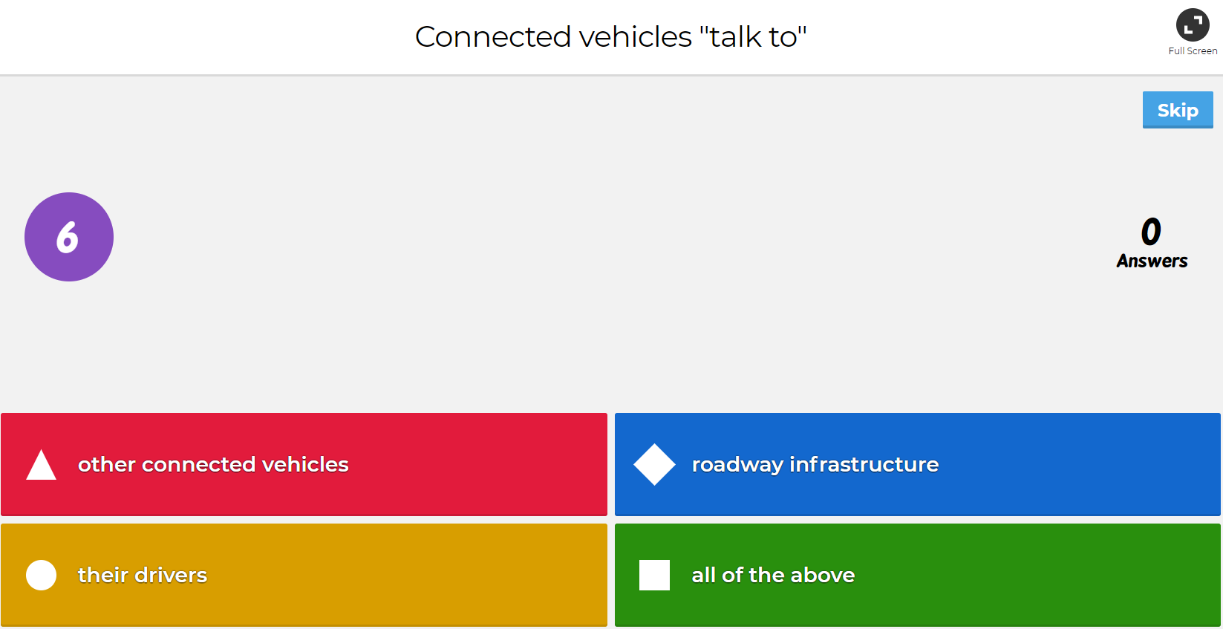

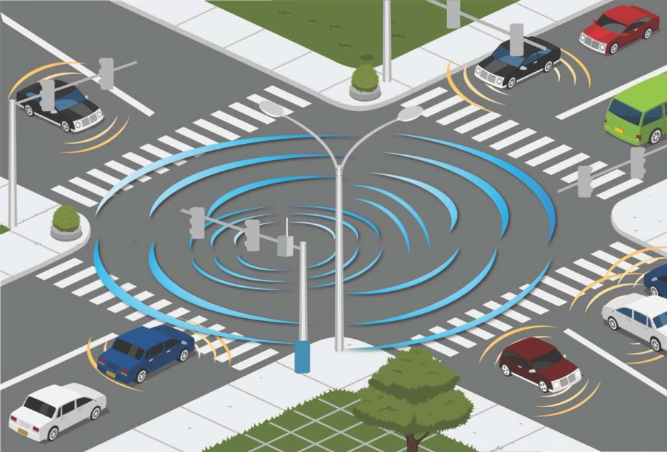
Question 5

Slide 10
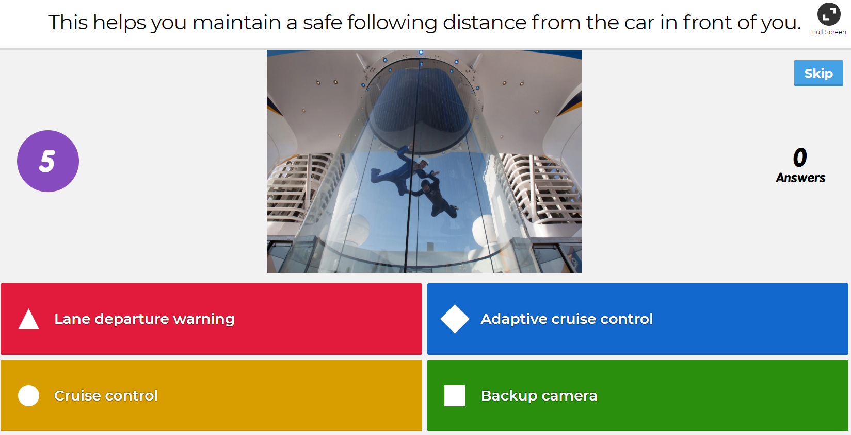
Question 6

Slide 11
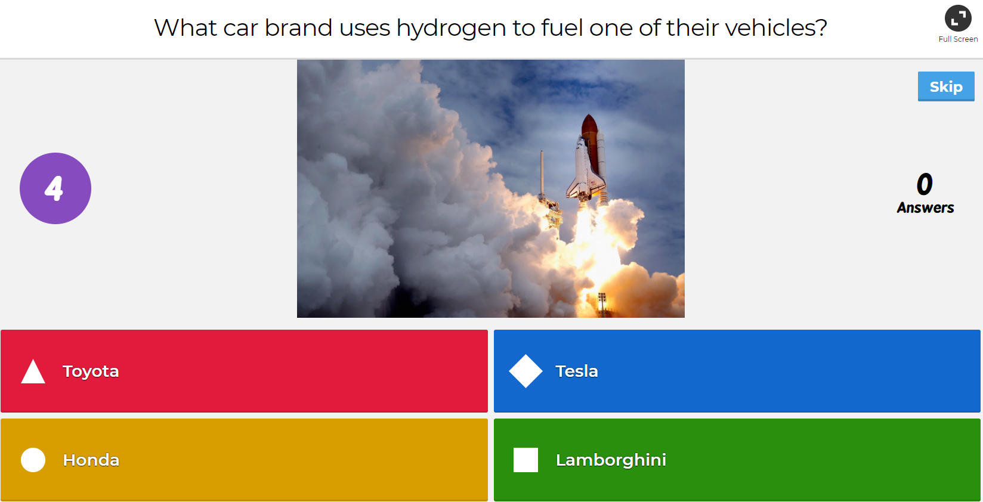

Question 7

Slide 12
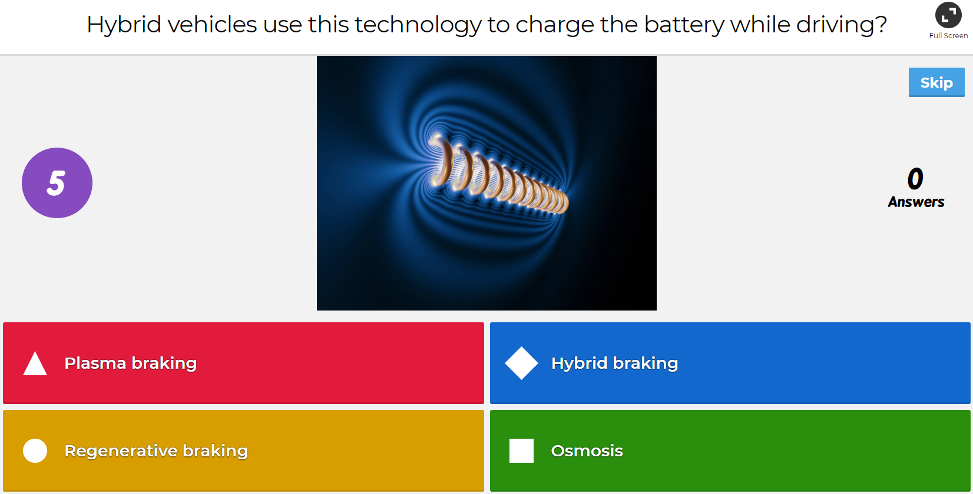

Question 8

Slide 13
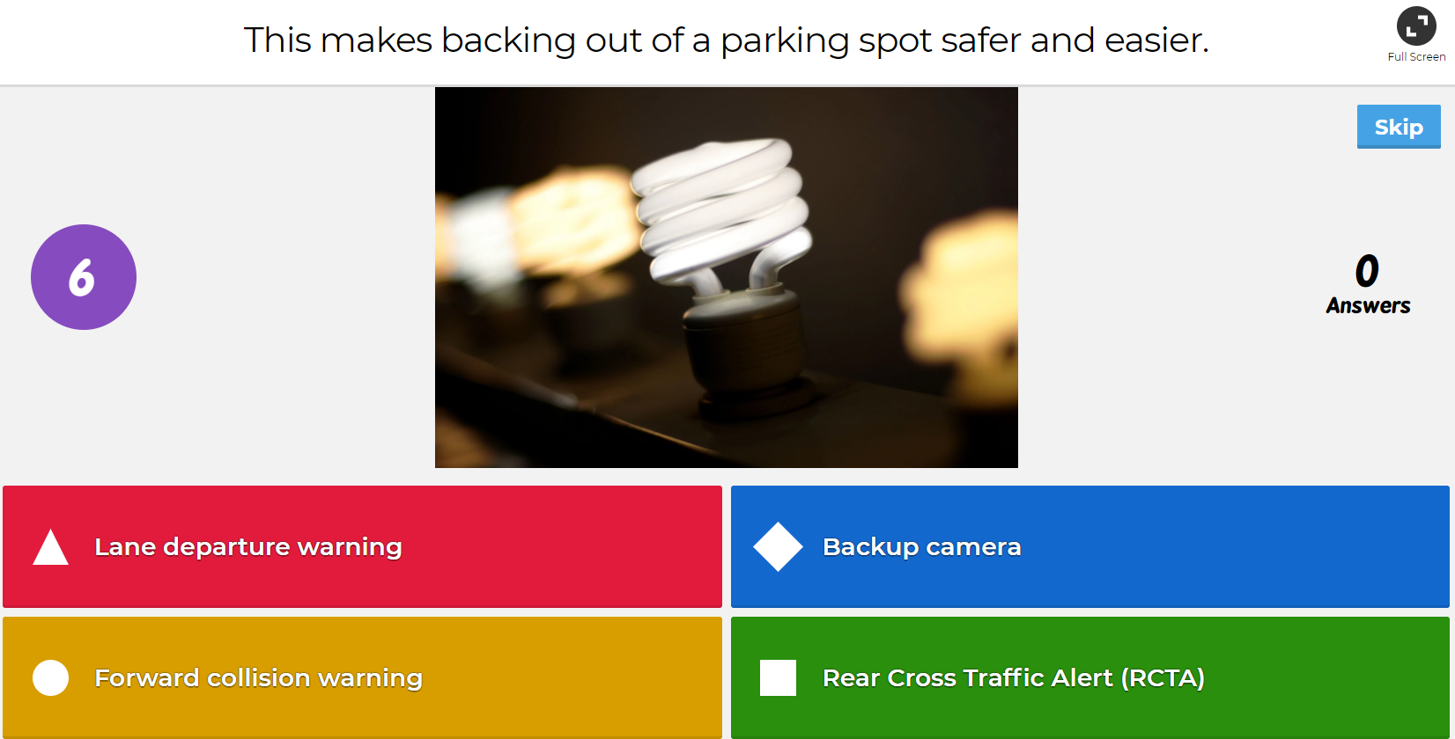
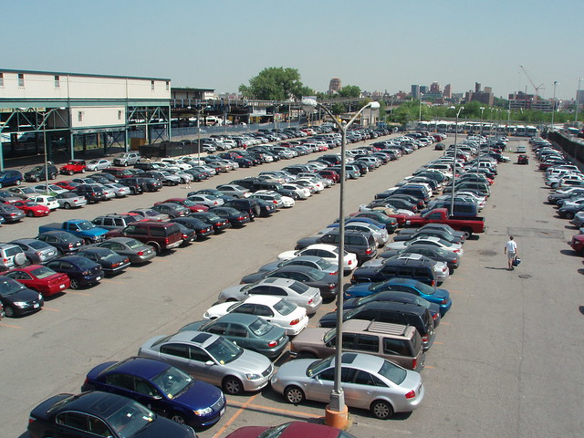

Question 9

Slide 14
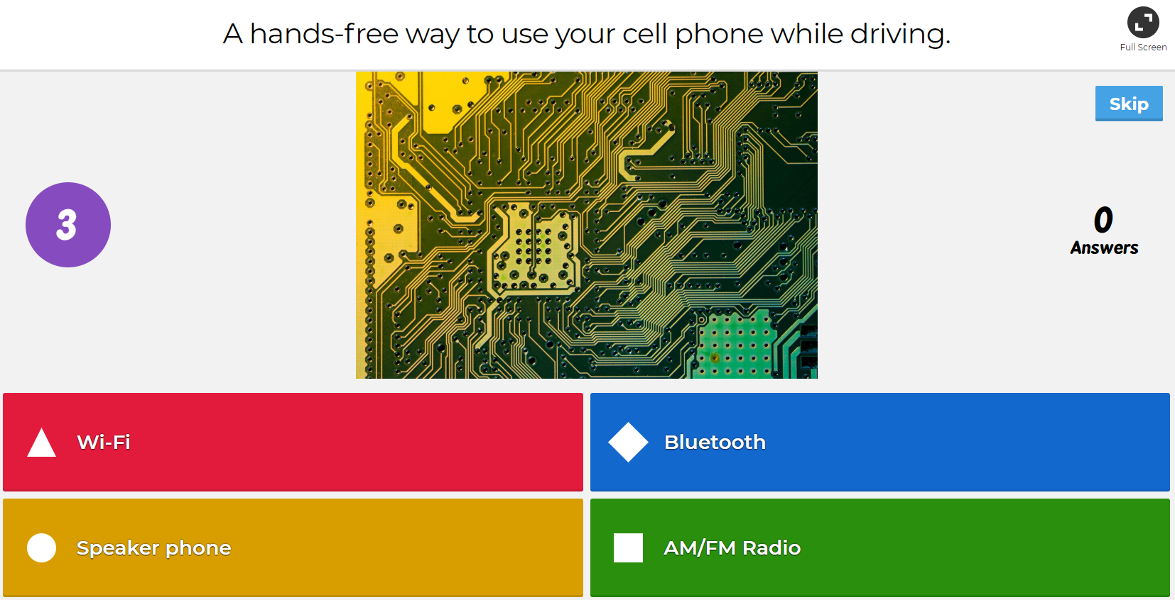

Question 10

