Slide 1
Transportation Technology
STEM in Transportation
2020

Slide 3
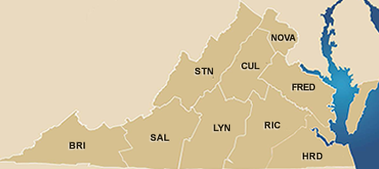
VDOT’s Task
To plan, build, & maintain the state’s roads, bridges, tunnels, and rest areas.
58,000 miles of roadway & bridges
4 under water tunnels & 2 mountain tunnels
41 rest areas & 100+ commuter lots

Slide 4
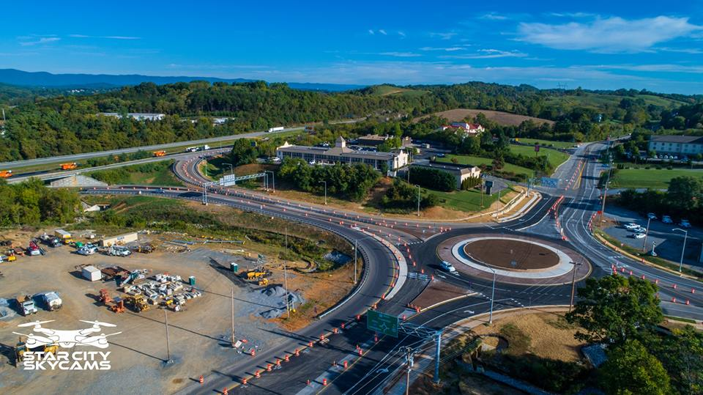
VDOT’s Mission
To plan, deliver, operate, and maintain a transportation system that is safe, enables easy movement of people and goods, enhances the economy and improves our quality of life

Slide 5
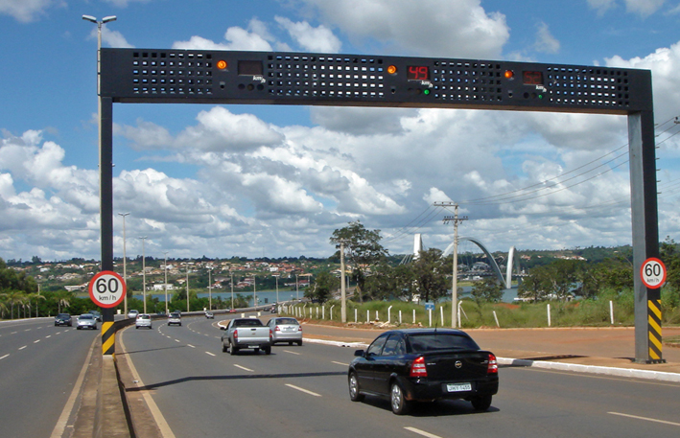
Modern transportation systems “know things”.
Notes:
Notice the vehicle speed displayed on the sign over each lane.

Slide 6
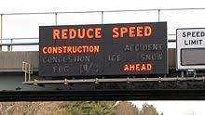
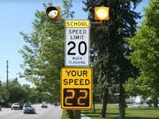
What do they know?
Your speed
Traffic volume
When you are waiting at a stoplight

Slide 7
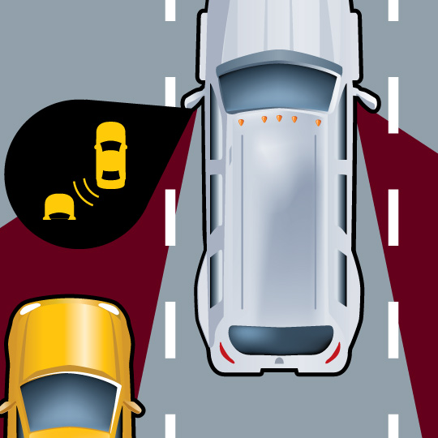
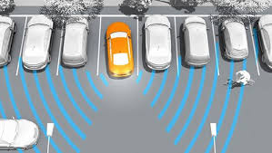
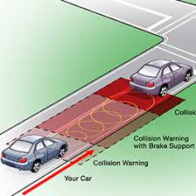
Blind spot detection
Rear Cross Traffic Alert
Forward Collision Warning
Notes:
Even the cars we are riding in, driving, or travelling with have ways of detecting certain objects or conditions. Every year new safety features or automation technologies are added to vehicles.

Slide 8
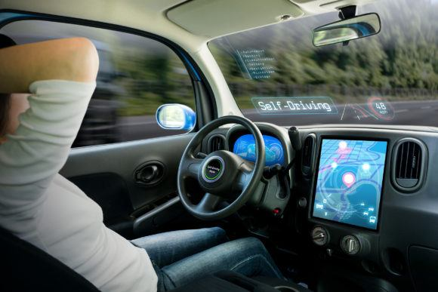

They are called Autonomous Vehicles
Some cars can even drive themselves!!
How do they do it?
Notes:
Think about all of the parameters a car would need to “know” to be able to drive without a human controlling it.
Speed limit
Where other cars are
Lane boundries
Stop signs and stop lights
When it is safe to change lanes
How hard it needs to break
Etc.

Slide 9

The magic is
SENSORS !!
And sensors use science!
Notes:
How do cars and our transportation system components “know” these things?

Slide 10
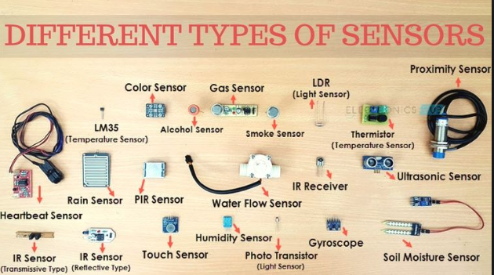
Notes:
What some sensors look light. Notice the wires, pins, connectors. They all have to be connected to an electronics system.

Slide 11
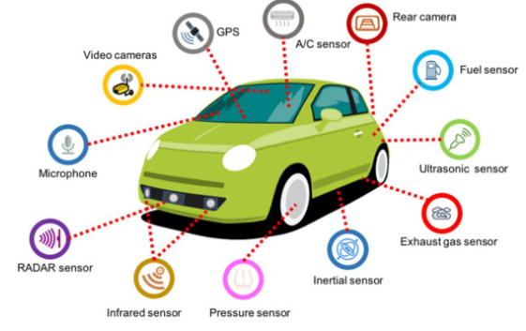
Sensors on Vehicles
Notes:
Some more of the sensors that might be on a vehicle.

Slide 12
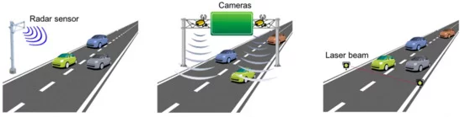
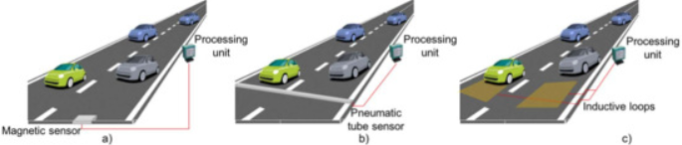
Sensors on the Road
Cameras
RADAR Sensor
Laser Beam
Pneumatic Tube
Sensor
Magnetic Sensor
Inductive Loops
Notes:
These are some technologies currently used on roadways.

Slide 13

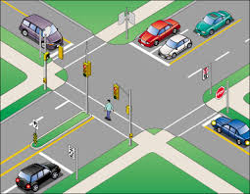
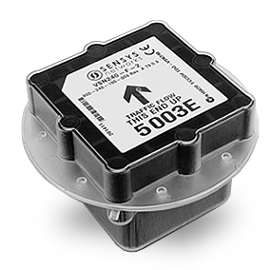
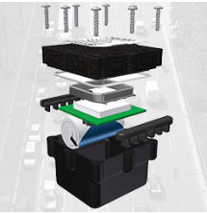
Magnetometer (magnetic field sensor)
Notes:
Let’s look at one type of sensor that VDOT uses in its systems, Magnetometers (magnetic field sensors).
The sensor shown above is a puck style that would be installed in a drilled out hole in the pavement. Apoxy would be used to cover the sensor and fill the hole. Another type of magenetic field sensors VDOT uses is a type that uses wires embedded in the pavement. They kind of look like a box outline. Again, apoxy is used to cover and fill the recess where the wire is installed. Both of these types of sensors would collect data and transmit it to a control box located nearby.

Slide 14
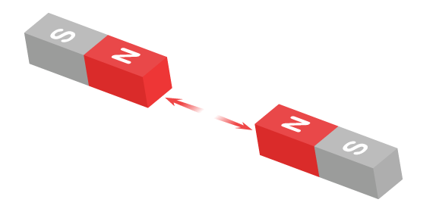
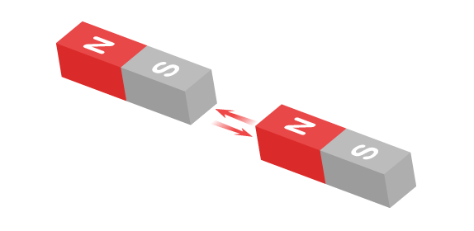
Magnets
Like poles push away from (repel) each other.
Opposite poles attract each other.
Notes:
To understand how a magnetic field sensor uses science, let’s think about what we already know about magnets.
We know that magnets have a north and south pole. We also know that magnets repel or attract each other depending on the orientation of the poles.

Slide 15
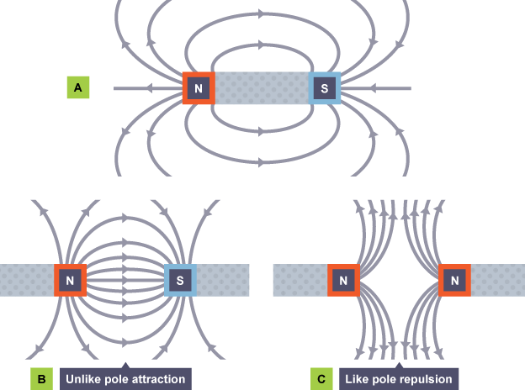
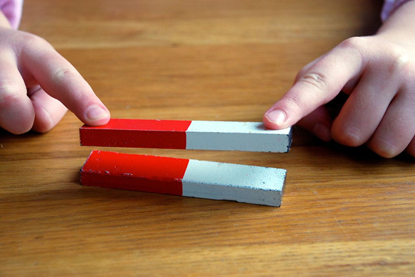
Magnets
The repulsion or attraction is caused by the magnetic field.
You can’t see it, but you can feel it.

Slide 16
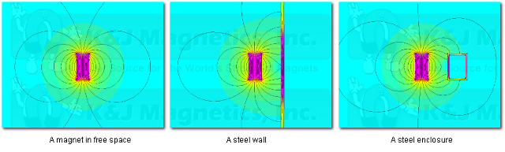
Magnetic Field Sensors
They measure magnetic fields (that force you feel)
Magnetic fields change when around metal
A sensor detects changes to the magnetic field when a vehicle is nearby
Magnet
in free space
Magnet
by a steel wall
Magnet
by a steel box
Notes:
The diagrams on the slide show how a magnetic field changes when close to a steel object. Metal causes changes to magnetic fields.
The Earth has a magnetic field, and objects interact with that field differently. Let’s see what happens to the Earth’s magnetic field around a car.

Slide 17
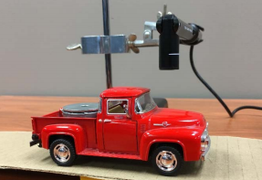
Magnetic Field Sensor Demo
Move the toy car under the sensor and see how the presence of metal affects the magnetic field.
What happened to the sensor reading?
Notes:
Using the magnetic field sensor in the STEM kit, set up the sensor and data display. Move the toy car under the sensor and notice the value of the magnetic field.
Tip: It is easiest to see the change in the field by viewing the data in graphical form versus just watching the numeric value.

Slide 18
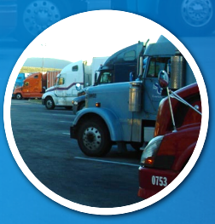
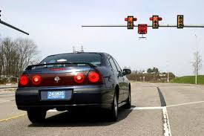
Where do we use magnetic field sensors?
Rest Areas / Truck Stops
Intersections with stop lights
To notify stop lights of a vehicle present.
To notify trucks of available parking.
Notes:
VDOT uses magnetic field sensors in several places. Two uses are shown on the slide.
When a car pulls up to a stop light and is there for a certain amount of time, their presence can trigger the light to cycle and change so they can go. This is used on secondary roads with less traffic so that main roads can keep heavily used roads moving and only stop them when necessary.
Truck drivers must stop and rest after a certain number of hours on the road. To help them locate empty parking spots at rest areas or truck stops, sensor are used to “count” the number of empty spaces available. That information can then be sent to a sign on the interstate or an app on phones to let drivers know where there is a place to park.

Slide 19
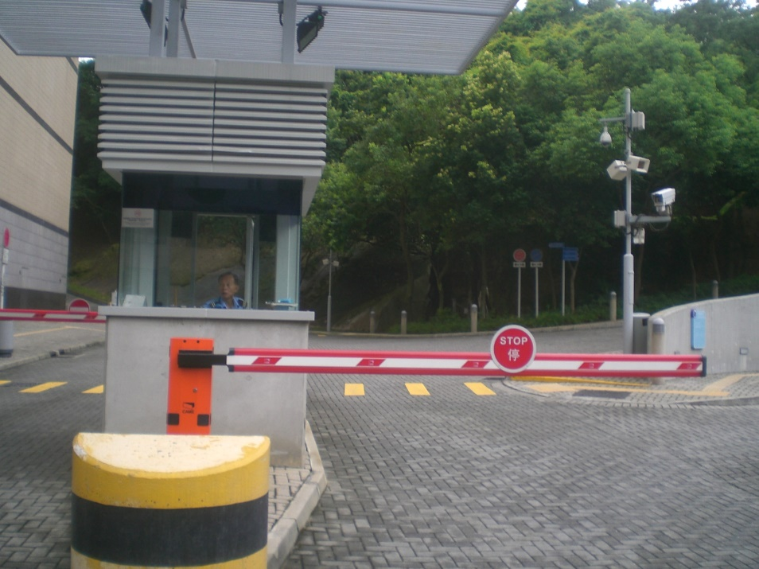
Other Uses
Entrance or Exit Gates
Some proximity sensors might be tripped by animals or people, but only vehicles would trip a magnetic field sensor
Can you think of other uses?

Slide 20
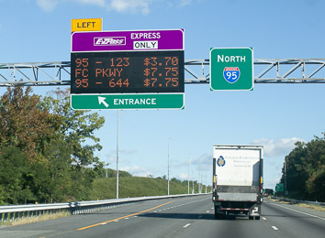
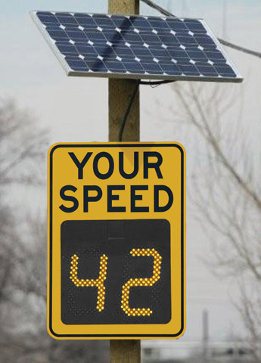
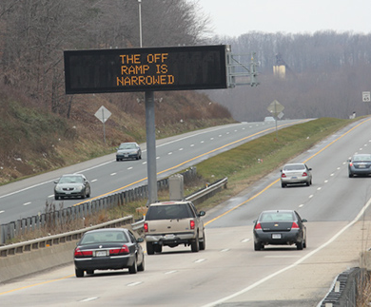
Integrating Sensors with Dynamic Message Signs
Dynamic message signs (DMS) use active, changeable displays to enhance roadway safety as part of an intelligent transportation system (ITS).
  School zones
  Curve warnings
  Pedestrian crossings
  Speed warnings
  Work zones
Best applied as a roadway safety enhancement at high-hazard locations or at high priority speed violation locations.
Notes:
Dynamic message signs (DMS) use active, changeable displays to enhance roadway safety as part of an intelligent transportation system (ITS).
IT systems do not have to be large and dynamic to be effective, sometimes a simple sign warning drivers how fast they are going can have a positive impact.
DMS may be used in school zones and as a way to provide curve warnings, identify or warn of upcoming pedestrian crossings, provide speed warning, alert drivers to upcoming work zones, etc.
They are best applied as a roadway safety enhancement at high-hazard locations or at high priority speed violation locations.

Slide 21
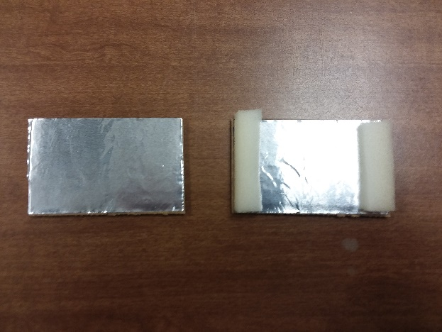
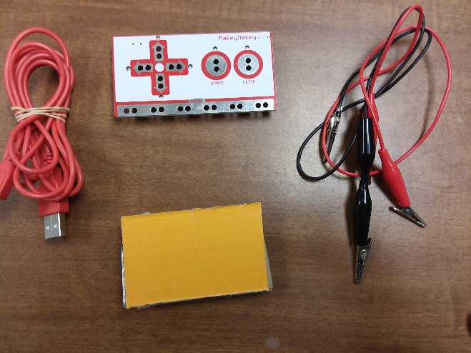
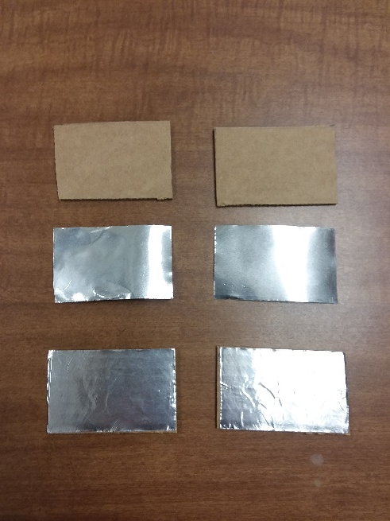
Your Turn!!
Create an interactive dynamic message sign that is triggered by a sensor
STEP 2
Cut two small pieces of foam that will fit between the two pieces of cardboard to create the sensor. Note: The thickness of the foam will determine how much force is needed to trigger the sensor. To create a sensitive sensor – use a thinner piece of foam.
STEP 3
Place the other piece of cardboard (aluminum side down) on top of the foam. Using a rubber band or tape, secure the two pieces of cardboard together with the aluminum sides facing each other and the foam between them. This will create the interactive sensor.
STEP 1
Attach the aluminum foil tape to one side of the cardboard pieces.
Notes:
You may be able to skip these steps if using pre-assembled “sensors”.

Slide 22
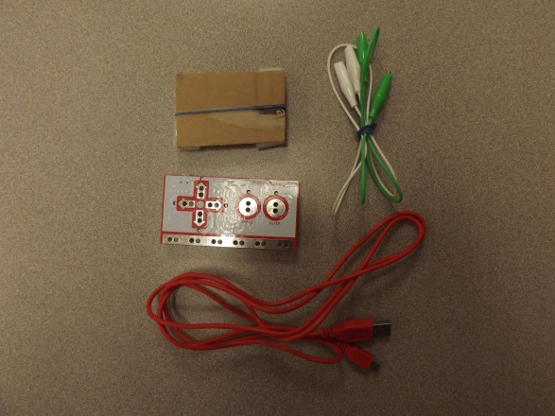
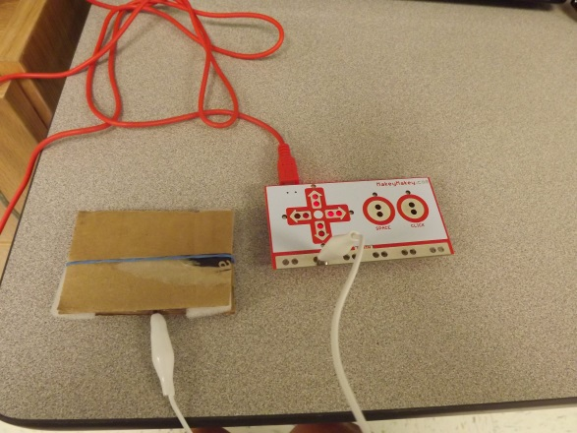
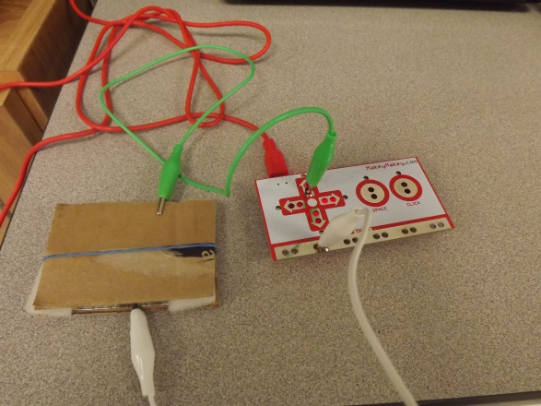
Creating An Interactive Dynamic Message Sign Cont.
STEP 1
Gather the materials from the Makey Makey kit and the sensor from Task 1.
STEP 2
Use the red USB cable to connect the Makey Makey to the computer for power. Use one of the alligator clips and connect one end to the “Earth” row on the Makey Makey. The other end should connect to the bottom of the sensor.
STEP 3
Finally, connect one end of the second alligator clip to the up arrow of the Makey Makey board. Then connect the other end to the top of the sensor.
Materials
Sensor
Makey Makey Board
USB Cable
2 Alligator Clips

Slide 23


Programming the Interactive Sensor
STEP 2
Once you have logged in, click on Create. This will take you to the programming area where you can program your sensor.
STEP 1
Navigate to the website – www.scratch.mit.edu and login using the login and password.

Slide 24



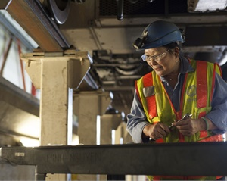
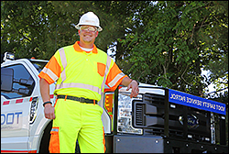
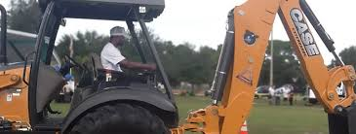
future transportation workforce
YOU are the

Slide 25
Resources
NanoSonic lessons
https://nanosonic.com/education/
Magnetic field image
https://d2jmvrsizmvf4x.cloudfront.net/yk6Ut6qnRQmg6jXFFFDi_7BBE4D56-A762-4B65-AB42-8EFB7191358D.png as of 12/12/2018
Magnetic field shielding image
https://www.kjmagnetics.com/blog.asp?p=shielding-materials
Car sensor image
Guerrero-Ibáñez, J.; Zeadally, S.; Contreras-Castillo, J. Sensor Technologies for Intelligent Transportation Systems. Sensors 2018, 18, 1212. https://www.mdpi.com/1424-8220/18/4/1212
Transportation careers information & lessons
http://www.transportationcareers.org/
VDOT STEM website
http://www.virginiadot.org/info/stem.asp

