Slide 1
Fall 2020
STEM Coordinator – Angela Parsley angela.parsley@vdot.virginia.gov
Communicating Designs
Notes:
At the Virginia Department of Transportation, our engineers have many tools to help them when designing and managing our transportation infrastructure (roads, bridges, traffic signs, signals, bike trails, etc.).

Slide 2
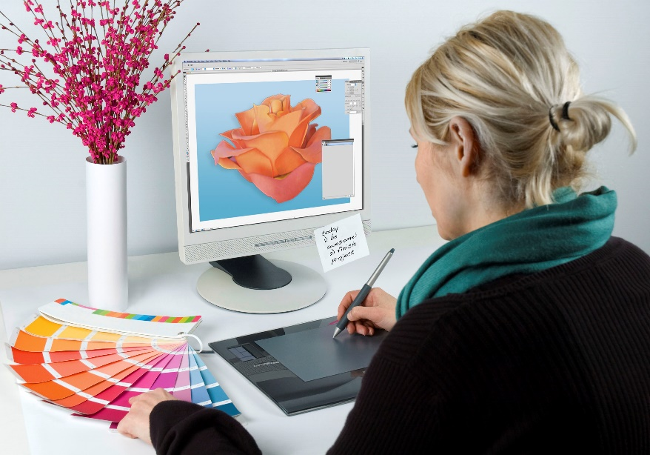

Who designs?
Landscape designers
Engineers
Industrial designers
Clothing designers
Interior designers
Architects
Inventors
Notes:
There are many people who design or must understand others’ designs in their work life.

Slide 3

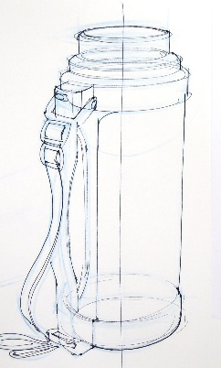
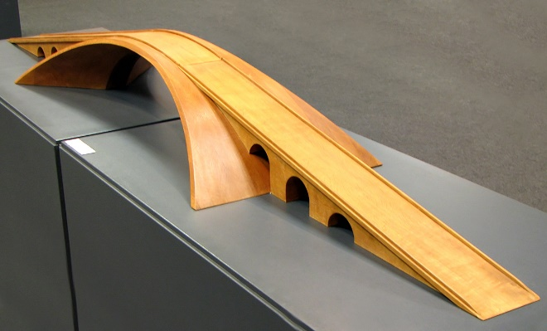
Communicating Designs
How do we communicate details about a design?
Describe the design
Sketches / Drawings
Pictures
Model or simulation
Notes:
Confucius and Frederick Barnard: “A picture is worth a thousand words”

Slide 4
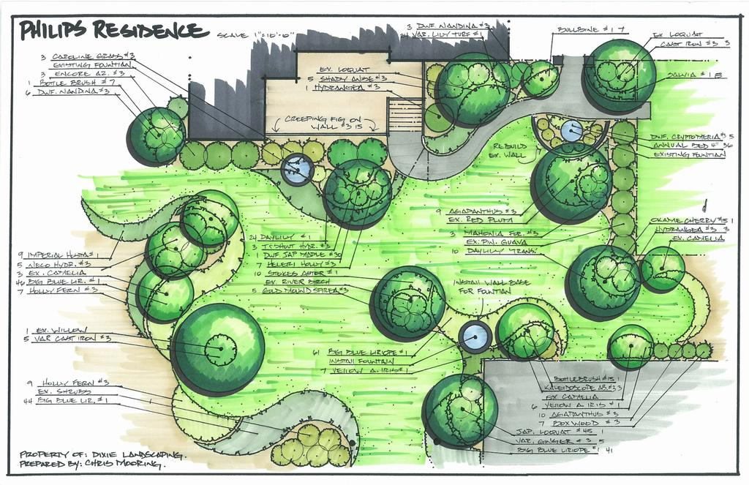
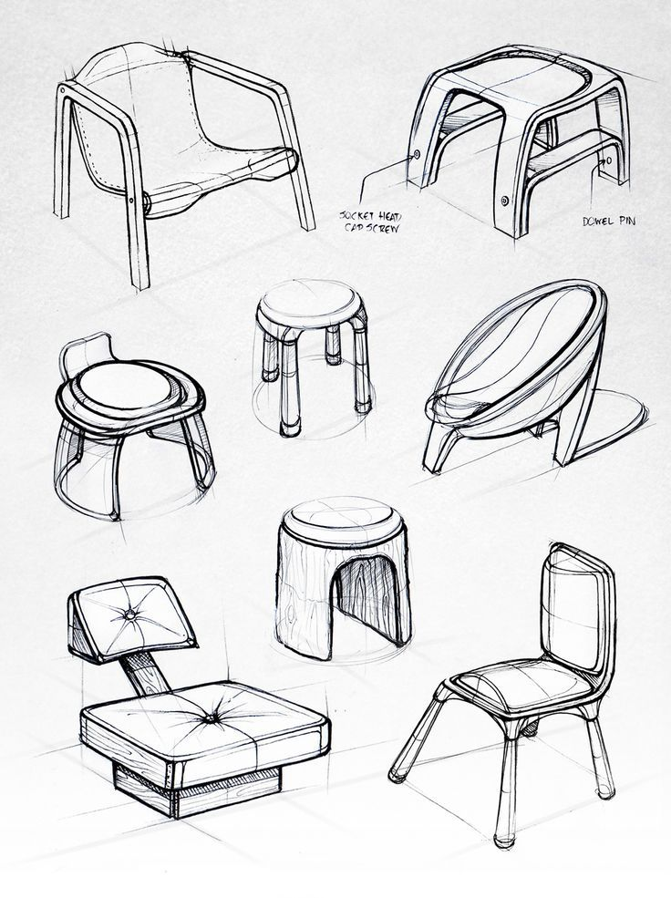
More Designs

Slide 5
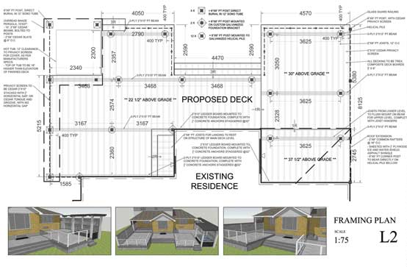
Technical Drawings
Models and sketches help us “see” the design, but they don’t usually provide enough detail for us to be able to “make/build” the design.
Technical Drawings: are drawings that are precise and provide adequate detail to be able to produce the design

Slide 6
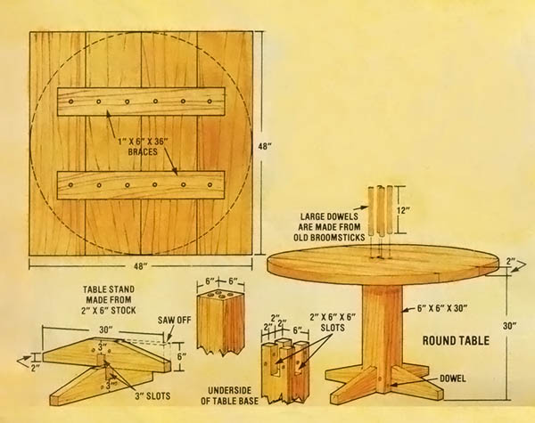
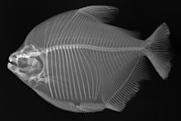
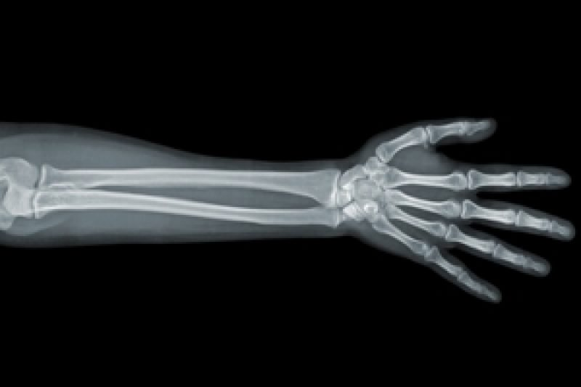
Even doctors must know how to interpret x-ray images to determine the extent of bone breaks or other injuries/conditions.
Technical Drawings
It’s important for everyone to be able to interpret technical drawings.
- furniture assembly
- building layouts / maps

Slide 7
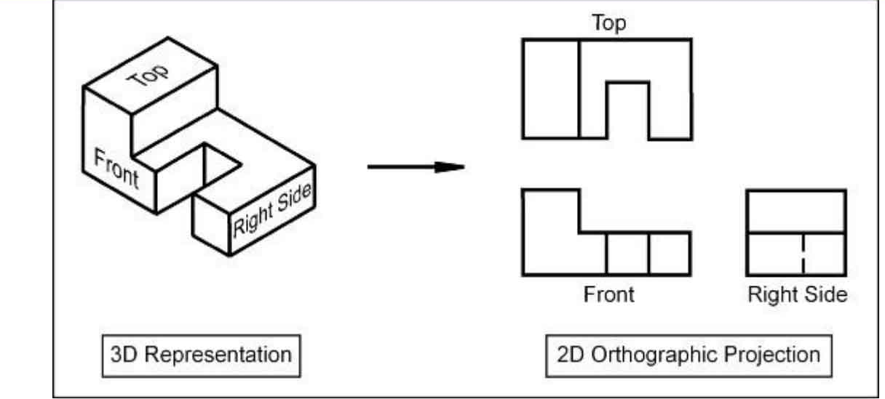
Drawing Object Views
New Roadways, Bridges, & Interchanges
Bridge Demo & Reconstruction
Paving
Notes:
It has been determined that most simple objects can be satisfactorily drawn with three views that will give all necessary design details of the object.
In some cases, only two views are needed (such as when a front and side view look identical.
In other cases, more than 3 views may be necessary; but as a general rule, 3 views is sufficient.
The addition of an isometric view (a type of 3D view) is usually very helpful when providing a technical drawing.
A set of 2D object views is called the orthographic views.

Slide 8
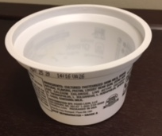
Object views
Photo of a yogurt cup
Notes:
Look at a picture of this yogurt cup.
What can you tell about the shape of it? ------ student will probably state that it is round
What about the bottom, can you tell if it is flat or not? ------- can’t tell from the picture

Slide 9
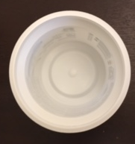
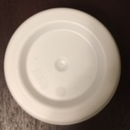
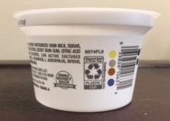
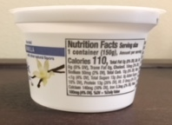
Object views
Top View
Regular Photo
Bottom View
Front View
Side View
Notes:
What if I show you a picture taken looking straight down at the cup (top view)? ----------- now you can start to see details about the bottom
What do you notice about the Front & Side Views (remember, ignore the wording & graphics)? --- they are the same shape
Sometimes you need to look at an object from many different angles to be able to see all of the details. Even then, hidden details may not be evident. Technical drawings can help you see hidden details.

Slide 10
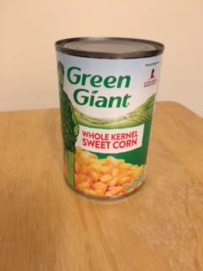
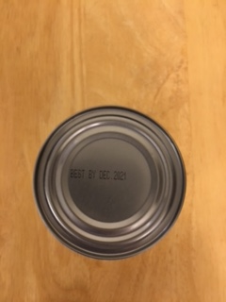
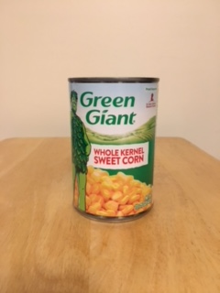
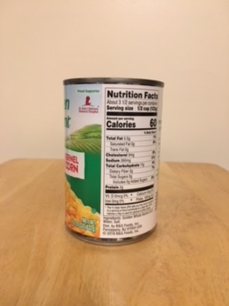
Try Drawing Orthographic Views
Grab 1 can of food.
Draw the shape of the TOP of the can.
What shape is the FRONT of the can?
What shape is the SIDE of the can?
Notes:
Let’s practice drawing the simple orthographic views of a can of food.
For the front and side views, “trace the edges” to see the overall shape.

Slide 11


Answer:
Grab 1 can of food.
Draw the shape of the TOP of the can.
What shape is the FRONT of the can?
What shape is the SIDE of the can?
Notes:
The top view should be a circle.
The side and front views will be rectangles.

Slide 12
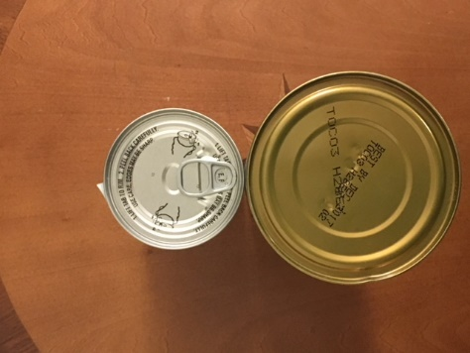
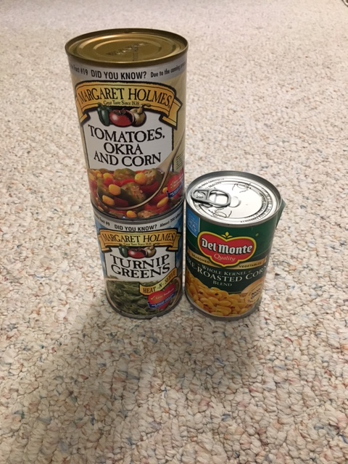
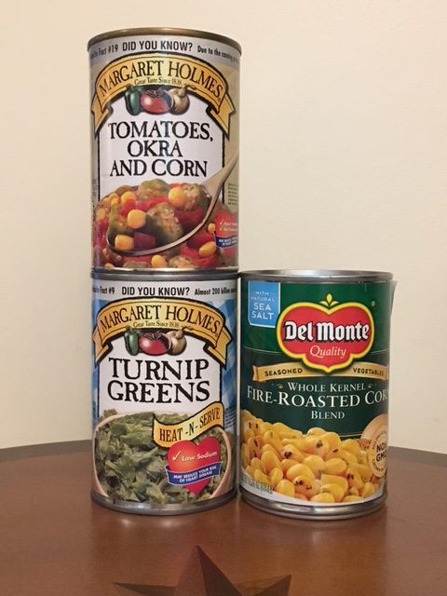
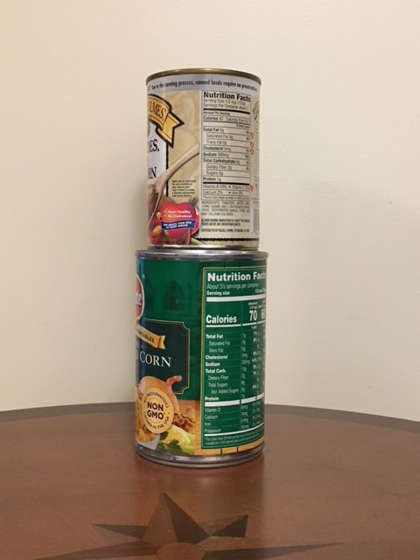
Draw More Orthographic Views
Draw the TOP view can structure
Draw the SIDE view of the cans
Draw the FRONT view of the cans

Slide 13

Answer:
Draw the TOP view can structure
Draw the SIDE view of the cans
Draw the FRONT view of the cans

Slide 14
Try Interpreting Orthographic Views!
Top View
Grab 6 cans of food and make this can structure.
Front View
Side View

Slide 15
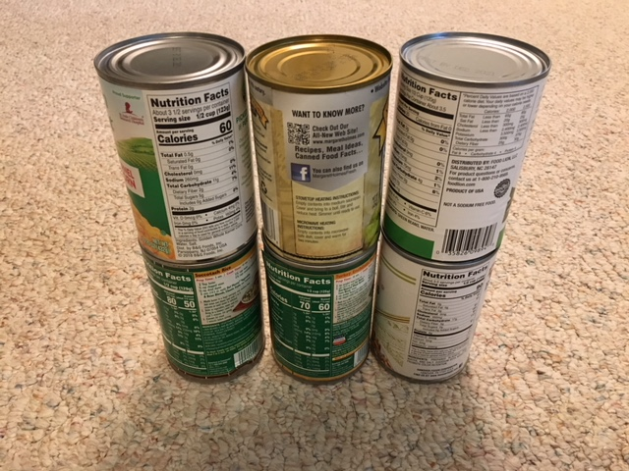
Answer:
3 cans across the bottom
3 cans stacked on top of the bottom layer

Slide 16
Try Another!
Top View
Front View
Side View

Slide 17
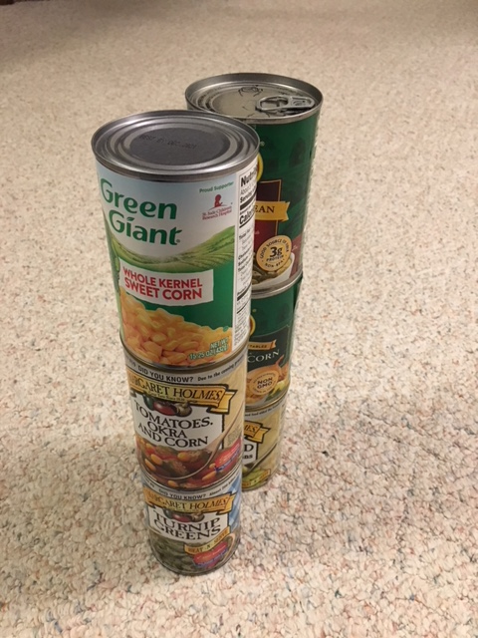
Answer:
Two stacks of three cans,
one stack in front of the other

Slide 18
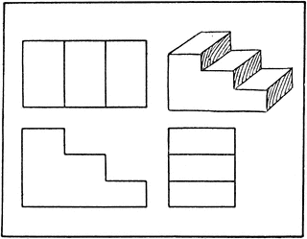
One More!
Top View
Front View
Side View

Slide 19
STAIRS !!
Top View
Front View
Side View
Notes:
The uncovered view is the Isometric View

Slide 20
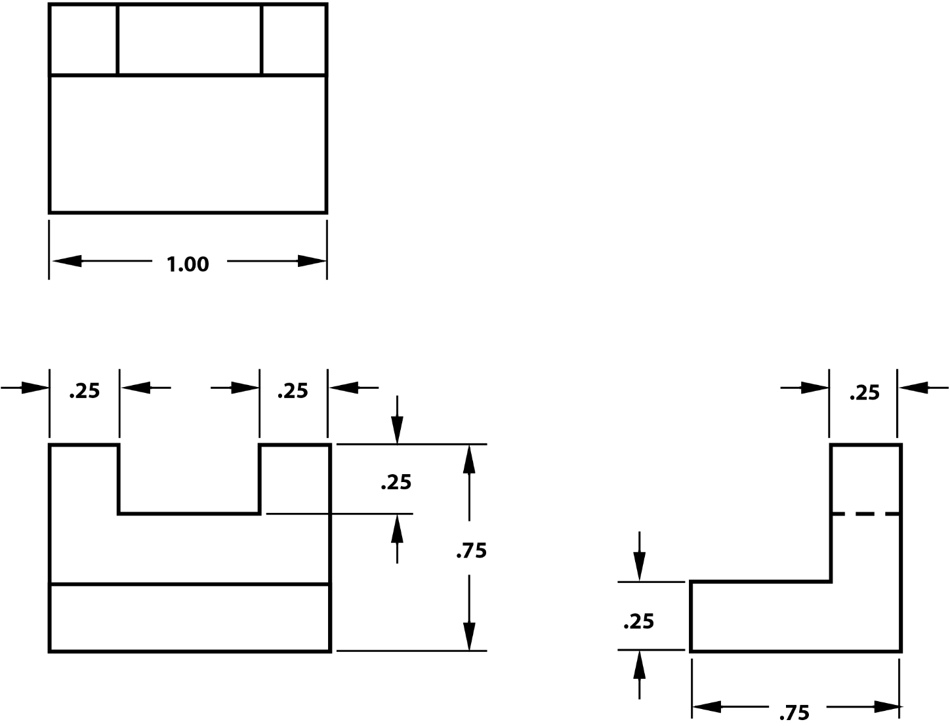
2D & 3D Drawings
Dimensions: the measurements of an item
(length, width, height, depth, radius, diameter)
2D (Two-dimensional):
- help us see hidden details
- dimensions stand out
3D (Three-dimensional):
- more realistic view
Notes:
Once you get the shape drawn, you will need to add dimensions so that designers know the size of objects.

Slide 21
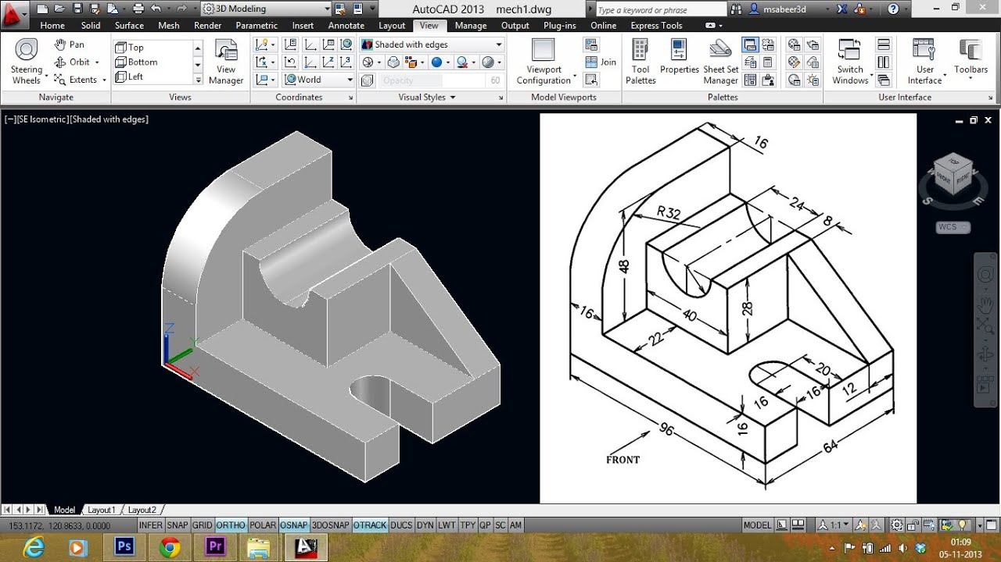
Alphabet of Lines
Technical drawings use standard types of lines to convey different information.
Visible line
Dimension line
Hidden line
Center line
and more…
Notes:
You may have noticed several different types of lines in some of the example drawings.
Technical drawings use standard types of lines to convey different information. This slide gives names of a few types of lines used.

Slide 22
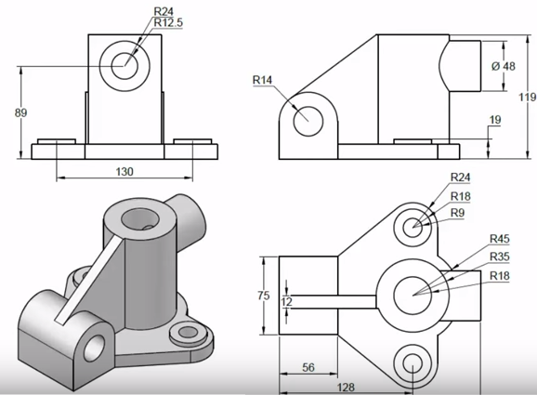
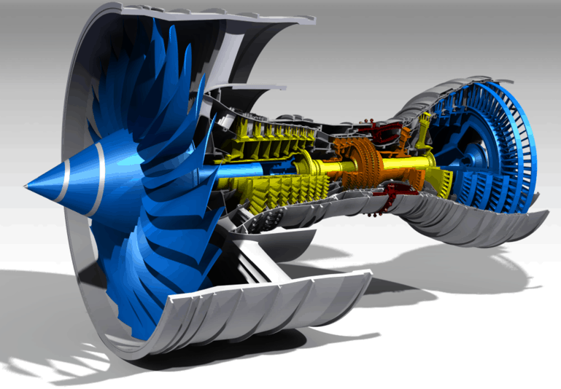
2D & 3D Drawings
Computer-Aided Design (CAD) programs allow us to make complex 3D drawings of objects
Notes:
Most designers use computer software to “draw” their designs.
These design software are called CAD (Computer-Aided Design) programs.
These drawings were created in CAD programs. The biggest advantage to a CAD program and how much easier it is to change a design/drawing detail. Before CAD software, drafters would have to redraw the entire drawing by hand every time there was a change.
CAD software also analyzes designs to ensure that parts will fit together in an assembly. This saves a lot of time when doing calculations.

Slide 23
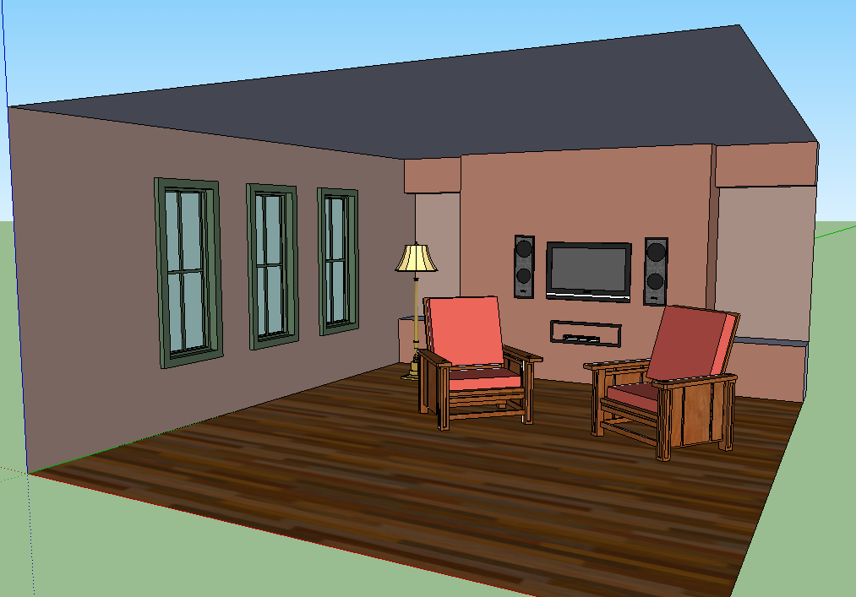
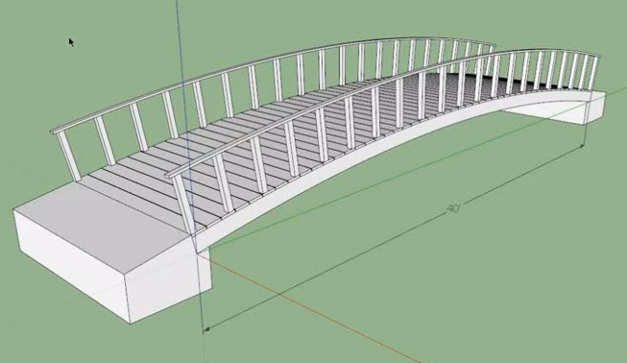
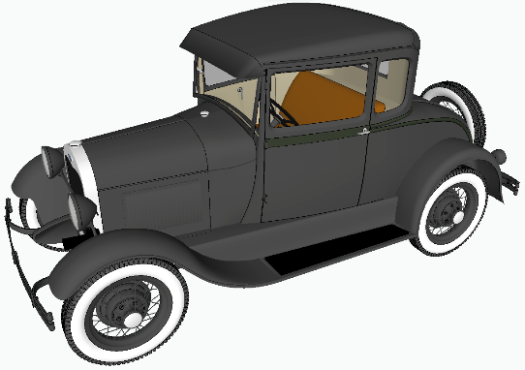
CAD Software
Many FREE programs out there
Do your homework, some offer more features or are easier to use than others
SketchUp - OnShape
AutoCAD student version
FreeCAD - LibreCAD
3D Builder
Notes:
There are many FREE CAD programs on the internet.
These drawings were all created in SketchUp. Notice that all CAD programs will use Cartesian planes to locate lines and points. This is a real life application of graphing skills you learn in school.

Slide 24
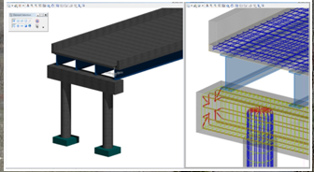
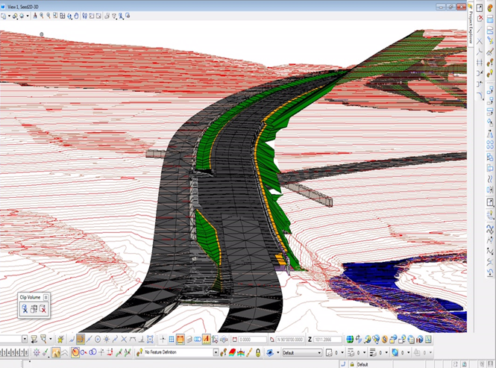
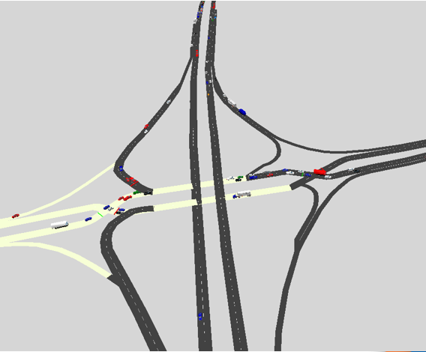
Design Software used at VDOT
Structure & Bridge Design
Road Design
Traffic Signal Design
Notes:
Here are some pictures of simulation software and CAD programs used at VDOT.
Each program offers different features and benefits, but they all help you visualize, communicate, and analyze designs.

Slide 25

Questions

Slide 26
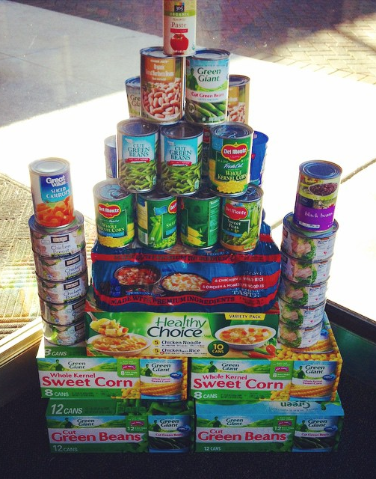
Can Challenge
Build some can towers/structures
Draw the front, top, & side views on a sheet of paper
Give the views to someone and see if they can build the structure from your drawings
You can do this with boxes, blocks, LegosTM, etc.

